Slide 1

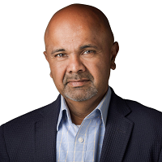
9 Habits of Highly Successful Fund Marketers

Paul Das
Founder + CEO - ProFundCom

Slide 2
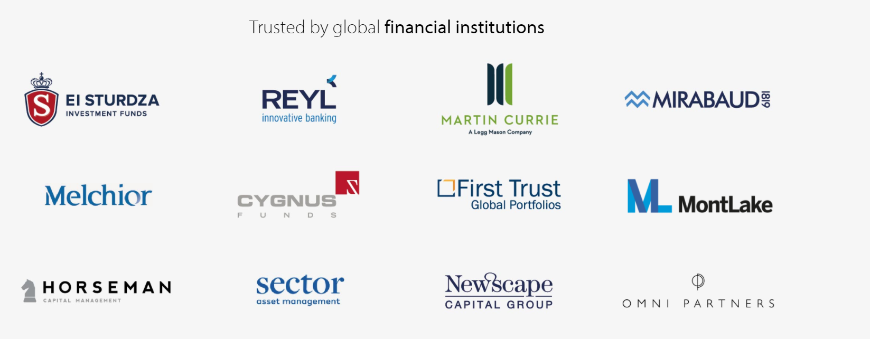


ProFundCom
Using Marketing Automation to Raise AuM
For the last 20 years we have helped fund managers raise assets using marketing automation

Slide 3
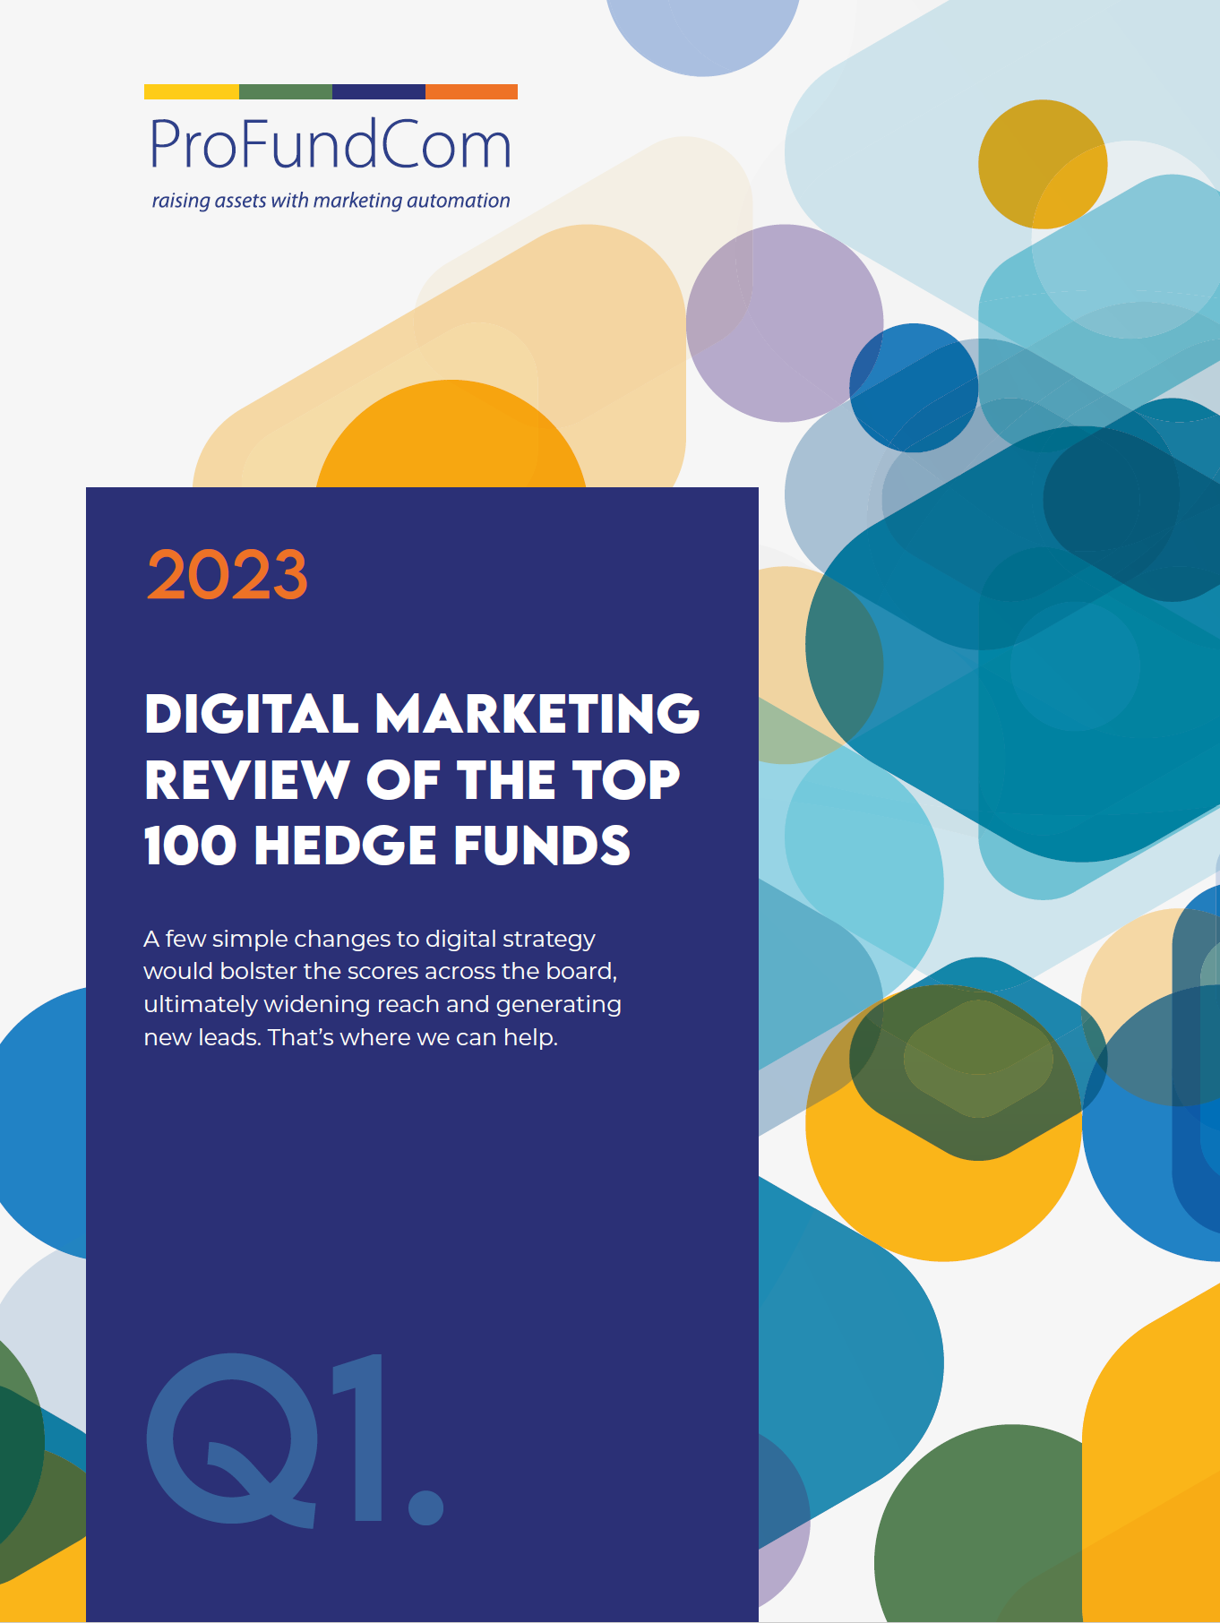
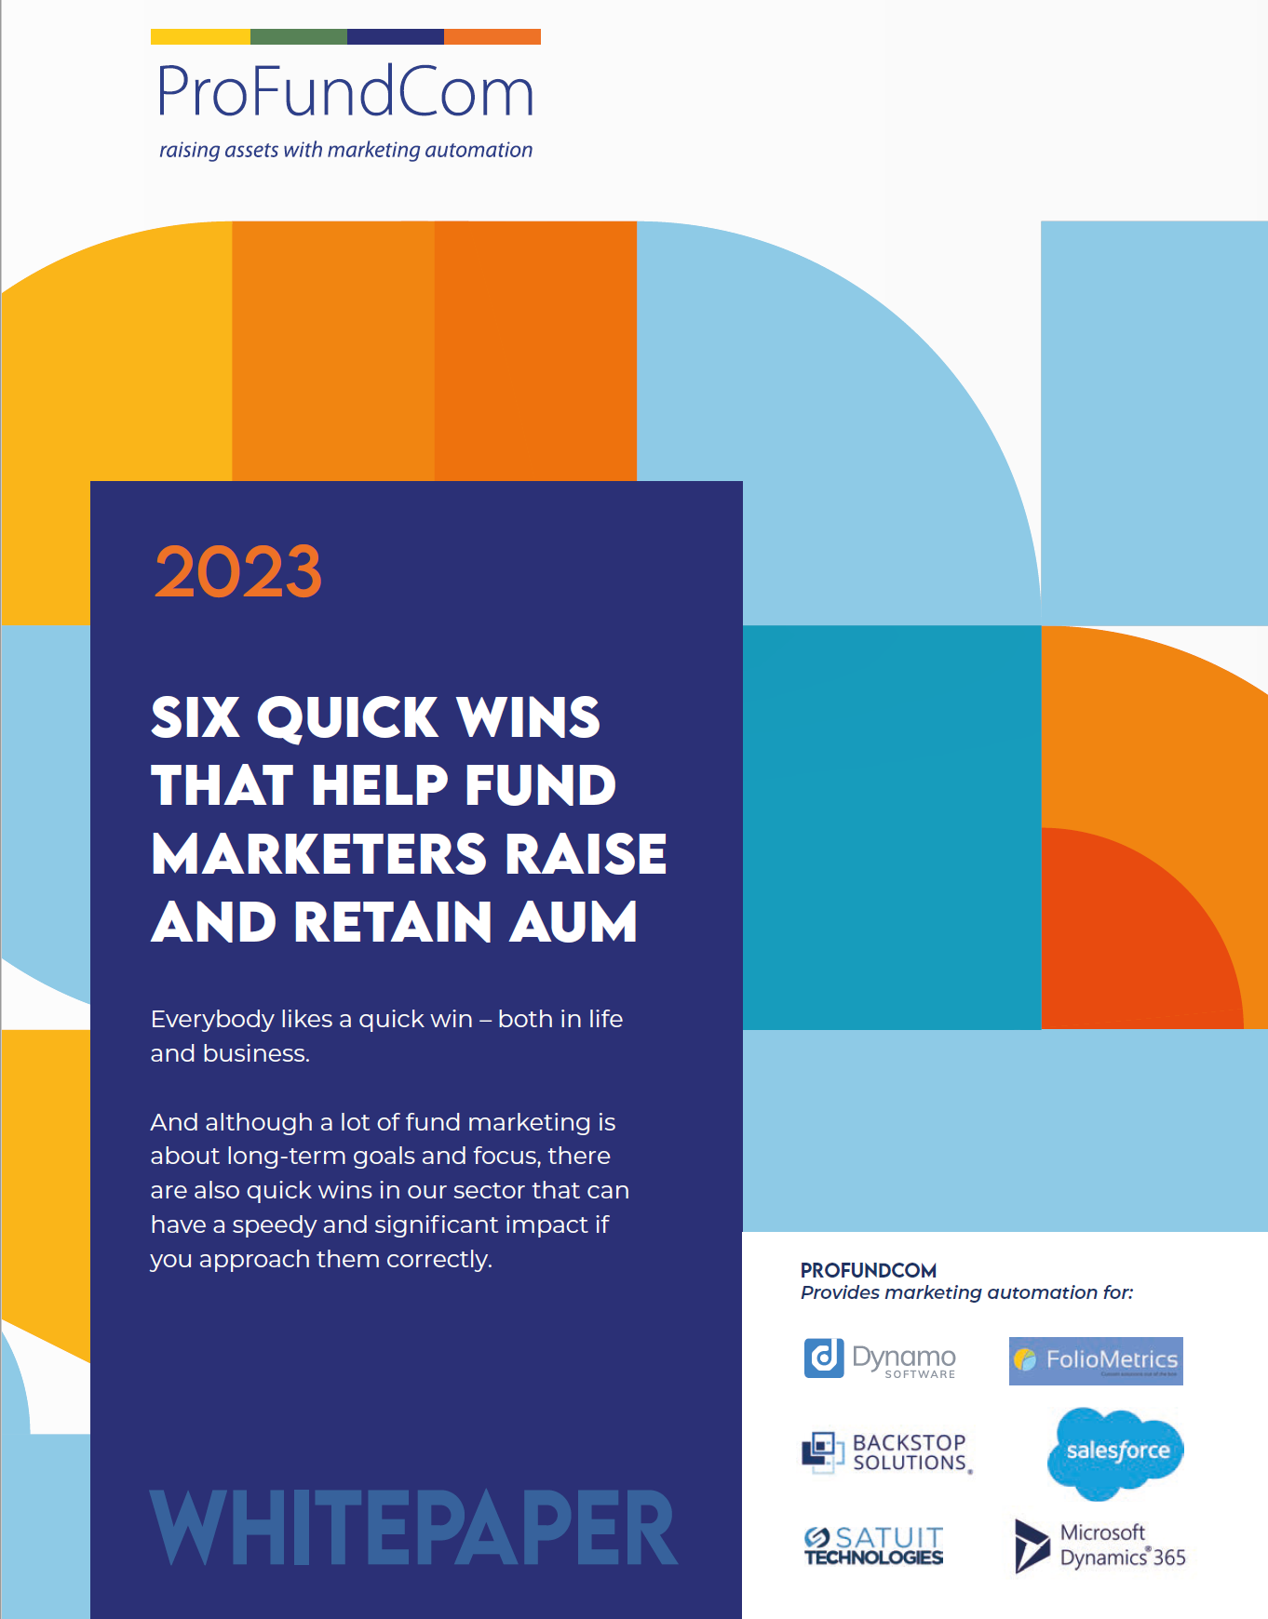
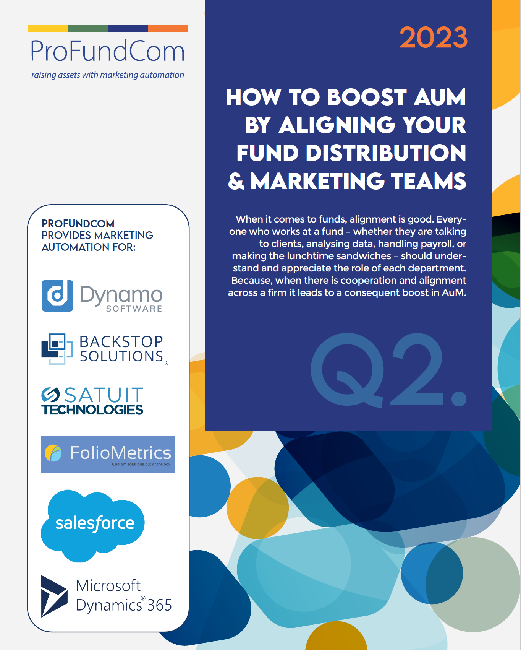
ProFundCom
Using Marketing Automation to Raise AuM
For the last 20 years we have helped fund managers raise assets using marketing automation

Slide 4
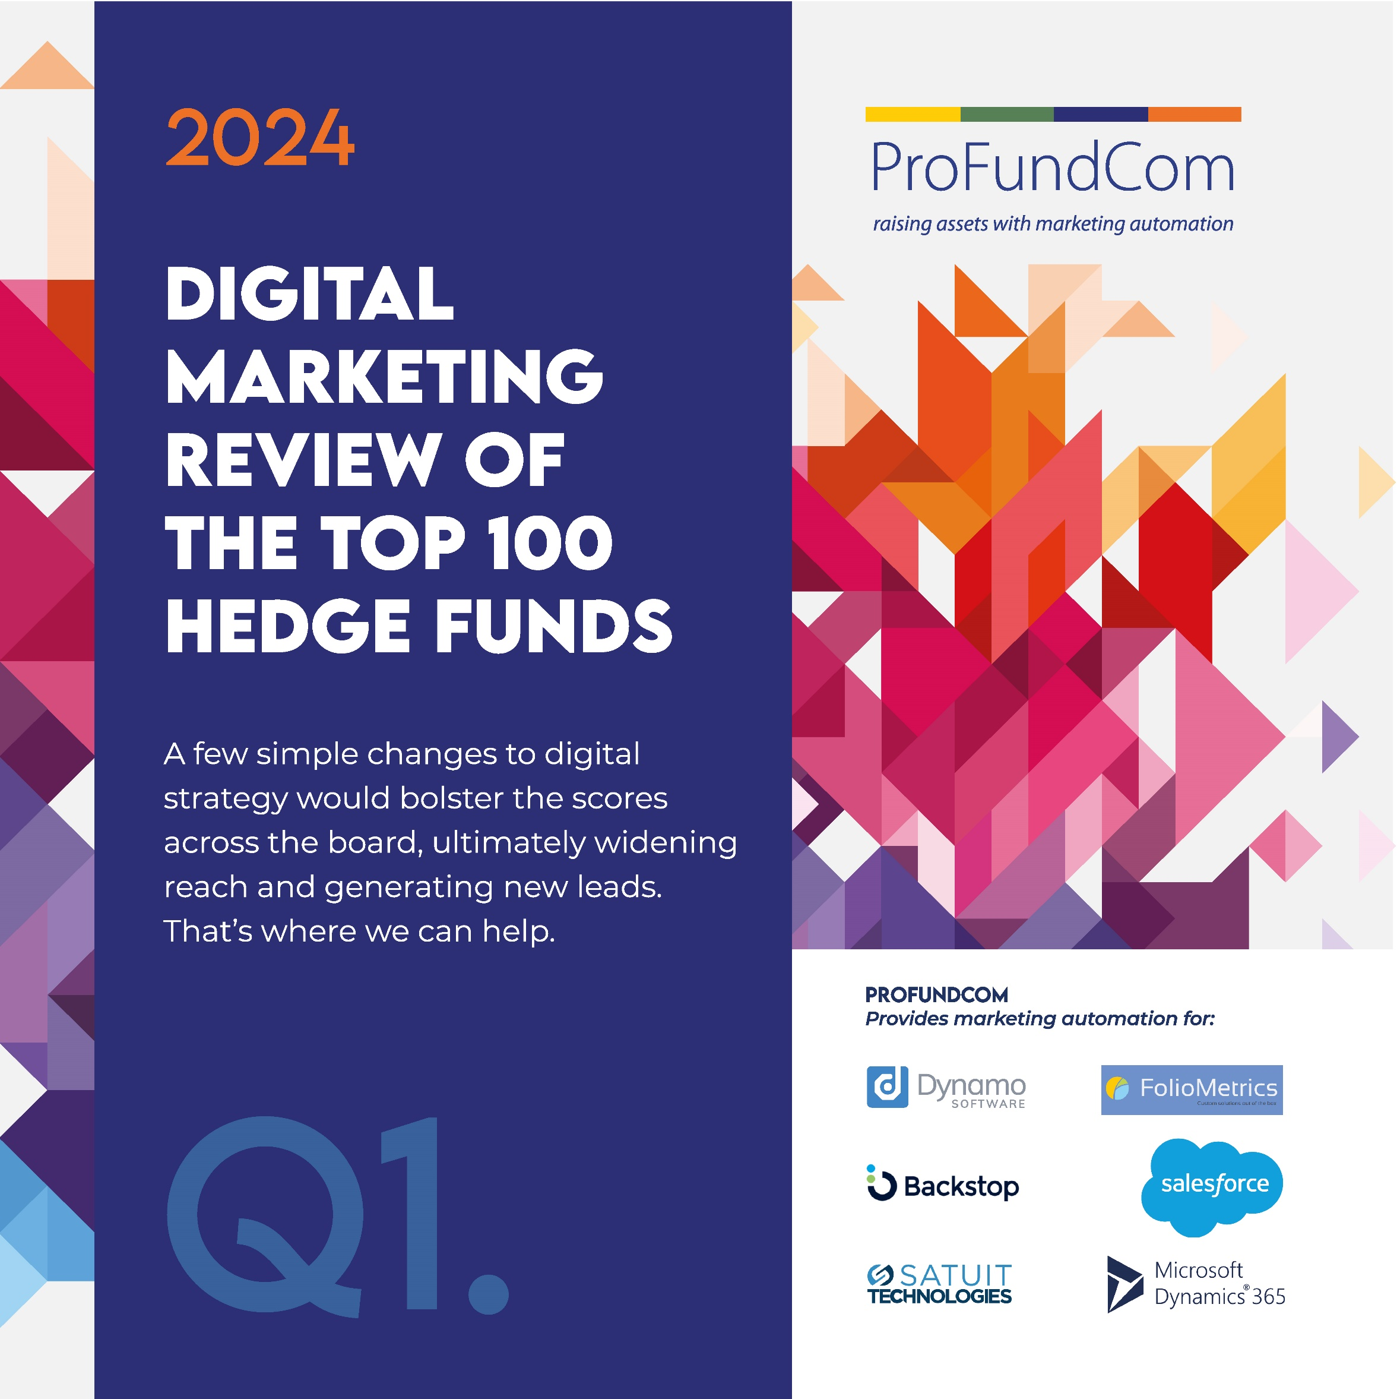
ProFundCom
Using Marketing Automation to Raise AuM
For the last 20 years we have helped fund managers raise assets using marketing automation

Slide 5
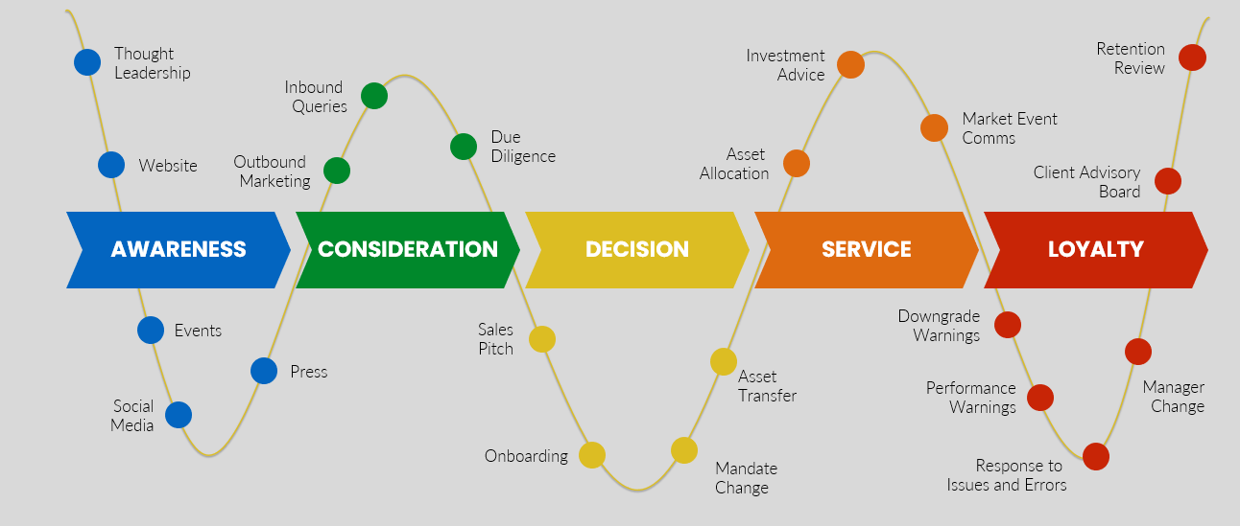
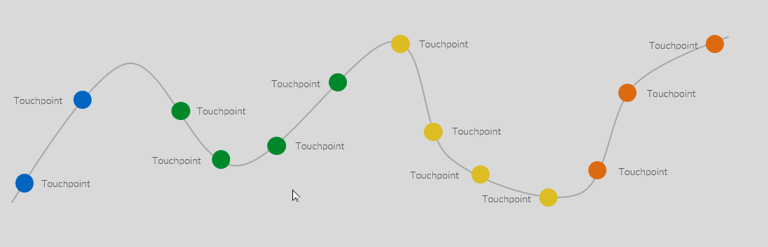
The Investor Journey
The Investor Journey is Totally Digital
What They Told Me
How It Is Going

Slide 6
GTM – Go To Market
The REAL Plan – IF YOU ONLY DO ONE THING
INVESTMENT
1
2
3
4
5
BRAND
AWARENESS
DEMAND
GENERATION
NARRATIVE
ENGAGEMENT
ANALYTICS
The what you do and the why you do it
Creating content about the narrative for your Ideal Investor
Creating channels for the Ideal Investor to Engage with your Narrative and Brand
(Outbound)
Creating a demand for your Ideal Investors and they Engage with you
(Inbound)
Track engagement and target the right Ideal Investor at the right time
START

Slide 7

AGTM – Automated Go To Market
Create A Marketing Echo Chamber
1
2
3
4
5
NARRATIVE
BRAND
DEMAND
ENGAGEMENT
ANALYTICS
The what you do and the why you do it
Creating content about the narrative for your Ideal Investor
Creating channels for the Ideal Investor to Engage with your Narrative and Brand
(Outbound)
Creating a demand for your Ideal Investors and they Engage with you
(Inbound)
Track engagement and target the right Ideal Investor at the right time
START

Slide 8
9 Habits of Highly Successful Fund Marketers
Do or Don’t – There Is No Try
1
Brand Experience
4
Data Analysis
01
04
2
Content Generation
5
Demonstrating RoI
02
05
3
Planning
6
Sales Enablement
03
06
7
Internal Collaboration
07
8
Education
08
3
Deploying the right tools
09

Slide 9
9 Habits of Highly Successful Fund Marketers
Do or Don’t – There Is No Try
1
Brand Experience
4
Data Analysis
01
04
2
Content Generation
5
Demonstrating RoI
02
05
3
Planning
6
Sales Enablement
03
06
7
Internal Collaboration
07
8
Education
08
3
Deploying the right tools
09

Slide 10
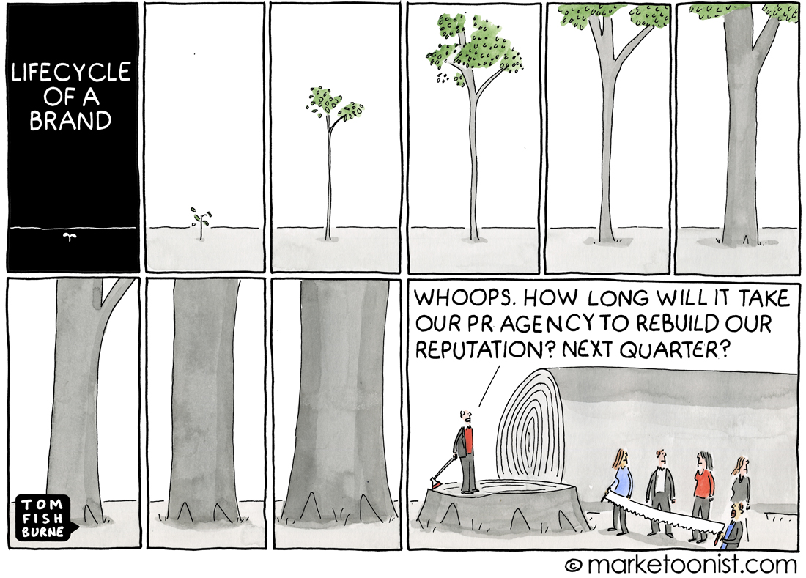
Brand Experience
The Good The Bad The Ugly

Slide 11
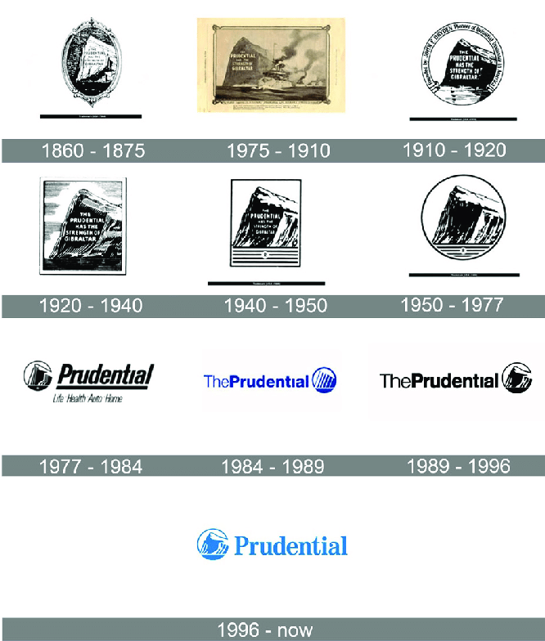
Brand Experience
The Good The Bad The Ugly

Slide 12
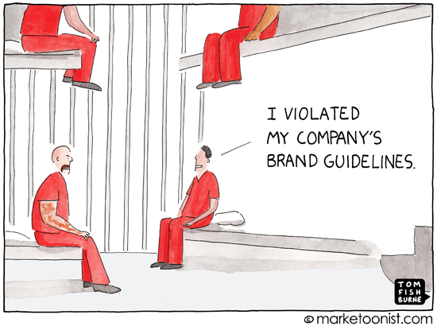
Brand Experience
The Good The Bad The Ugly

Slide 13
9 Habits of Highly Successful Fund Marketers
Do or Don’t – There Is No Try
1
Brand Experience
4
Data Analysis
01
04
2
Content Generation
5
Demonstrating RoI
02
05
3
Planning
6
Sales Enablement
03
06
7
Internal Collaboration
07
8
Education
08
3
Deploying the right tools
09

Slide 14
Content Generation
Is Failure an Option?
Blogs
Thought
Leadership
Investment
Strategy
Webinars

Slide 15

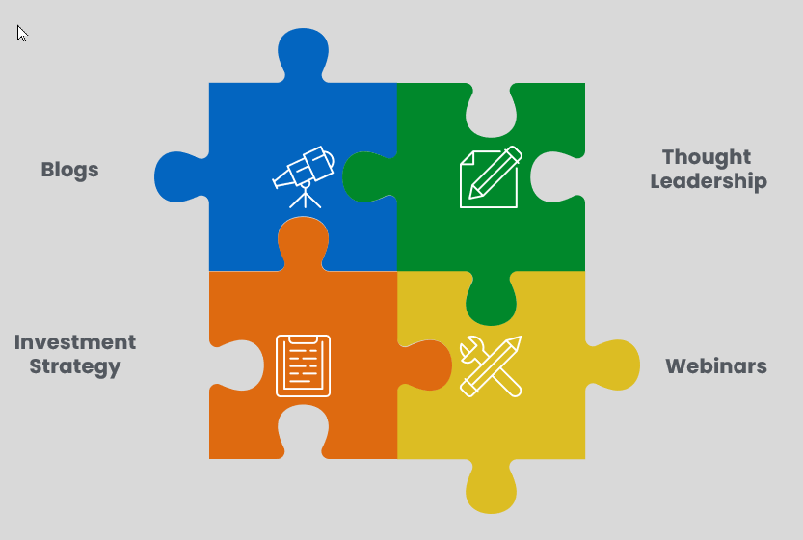
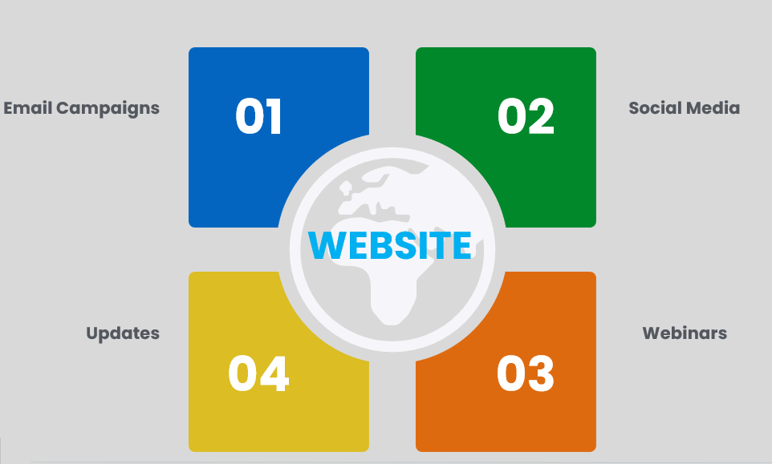
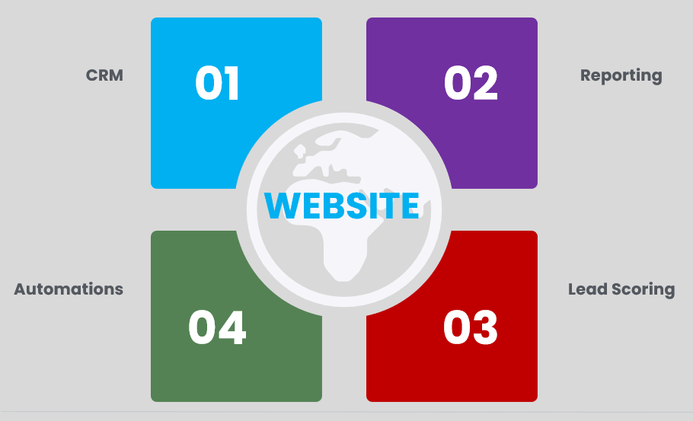


Multiformat
Not just VHS and BetaMax

Slide 16

Content Generation
Write Once – Use Many
Webinar
Whitepaper
Article
LinkedIn
Tweet

Slide 17
9 Habits of Highly Successful Fund Marketers
Do or Don’t – There Is No Try
1
Brand Experience
4
Data Analysis
01
04
2
Content Generation
5
Demonstrating RoI
02
05
3
Planning
6
Sales Enablement
03
06
7
Internal Collaboration
07
8
Education
08
3
Deploying the right tools
09

Slide 18
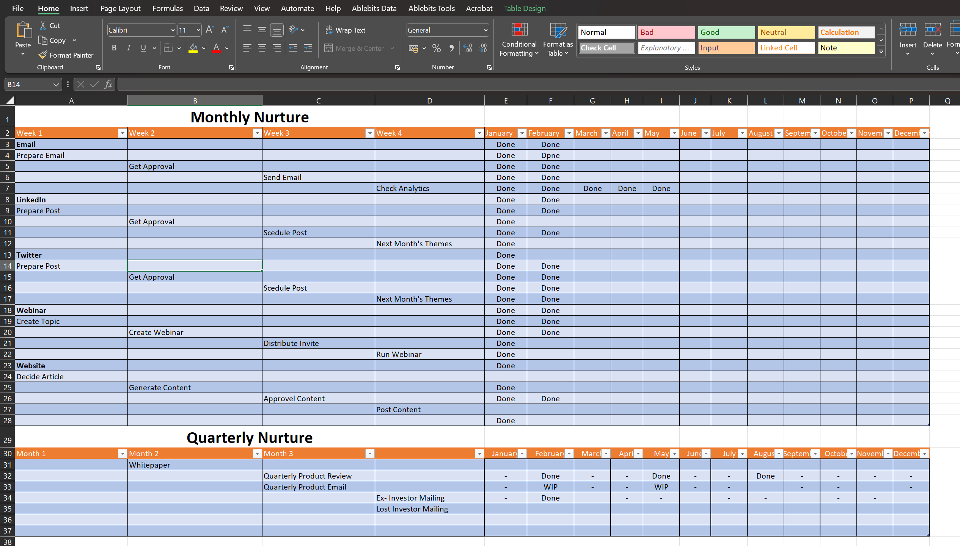
Plan to Fail or Fail to Plan
Everyone had a plan – till they are punched in the face

Slide 19
9 Habits of Highly Successful Fund Marketers
Do or Don’t – There Is No Try
1
Brand Experience
4
Data Analysis
01
04
2
Content Generation
5
Demonstrating RoI
02
05
3
Planning
6
Sales Enablement
03
06
7
Internal Collaboration
07
8
Education
08
3
Deploying the right tools
09

Slide 20
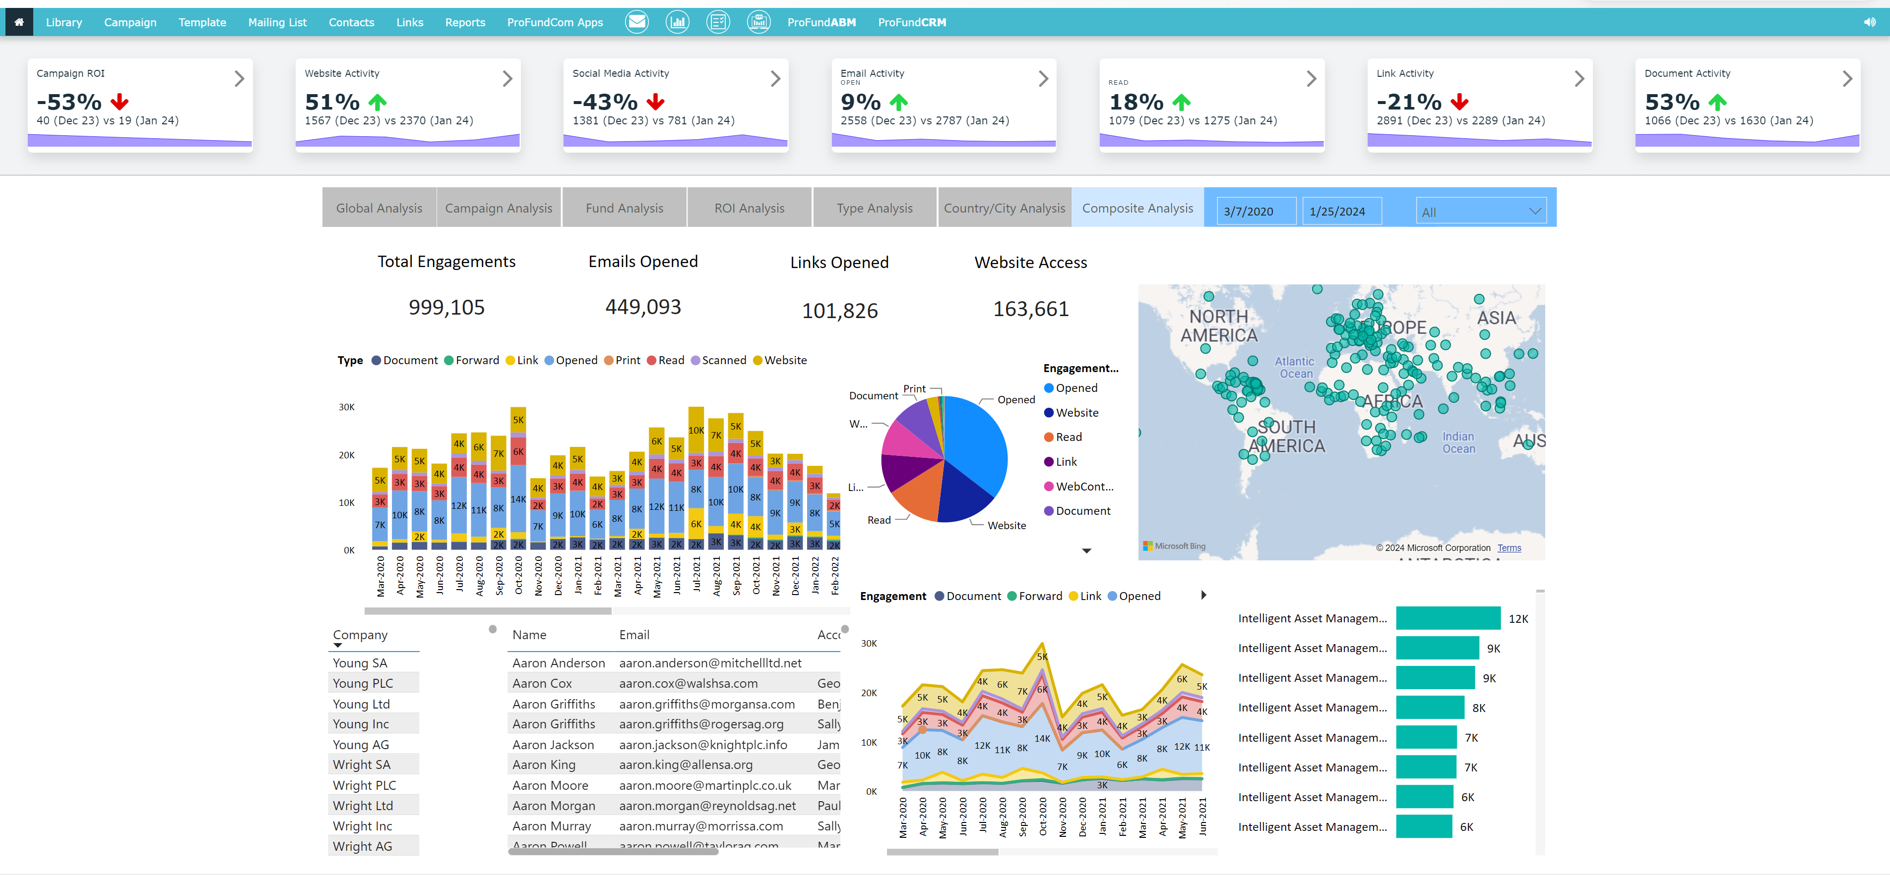
Data Analysis
Dashboards

Slide 21

Data Analysis
Dashboards

Slide 22
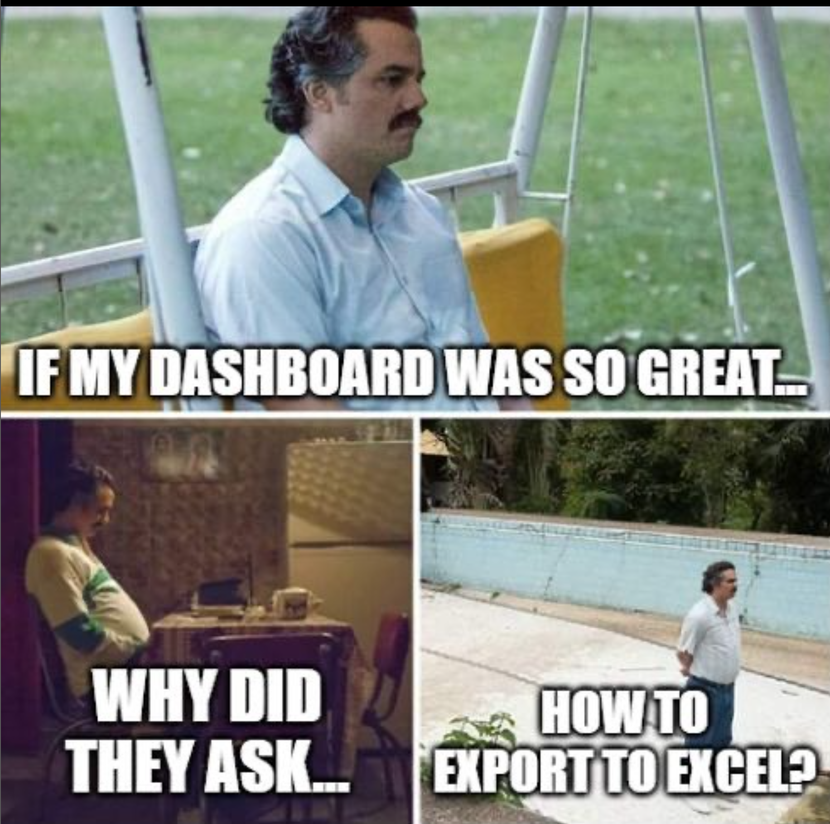
Data Analysis
Dashboards

Slide 23
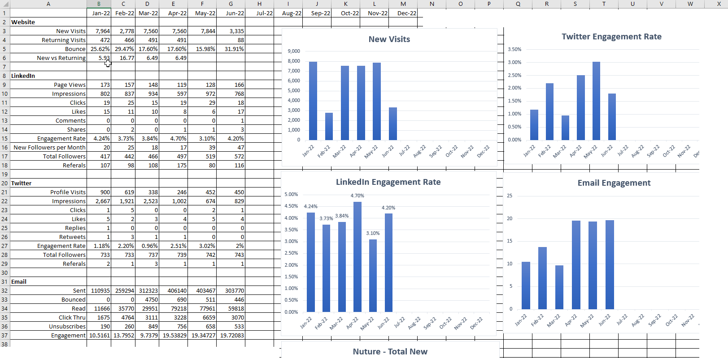
Data Analysis
Mean – Median – Mode - Charting

Slide 24
9 Habits of Highly Successful Fund Marketers
Do or Don’t – There Is No Try
1
Brand Experience
4
Data Analysis
01
04
2
Content Generation
5
Demonstrating RoI
02
05
3
Planning
6
Sales Enablement
03
06
7
Internal Collaboration
07
8
Education
08
3
Deploying the right tools
09

Slide 25
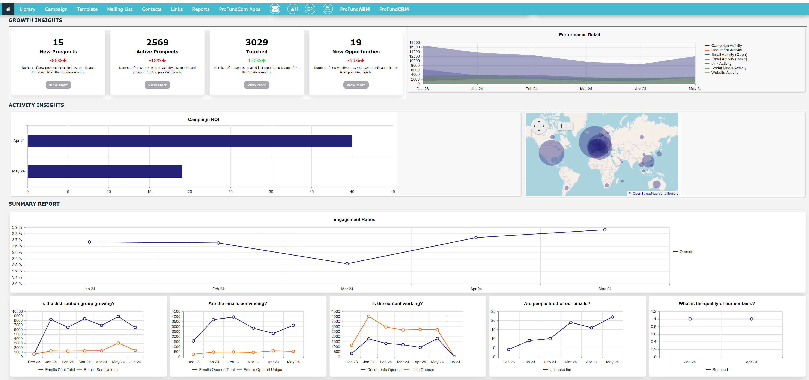
Demonstrating RoI
What demonstrates the value of marketing spend

Slide 26
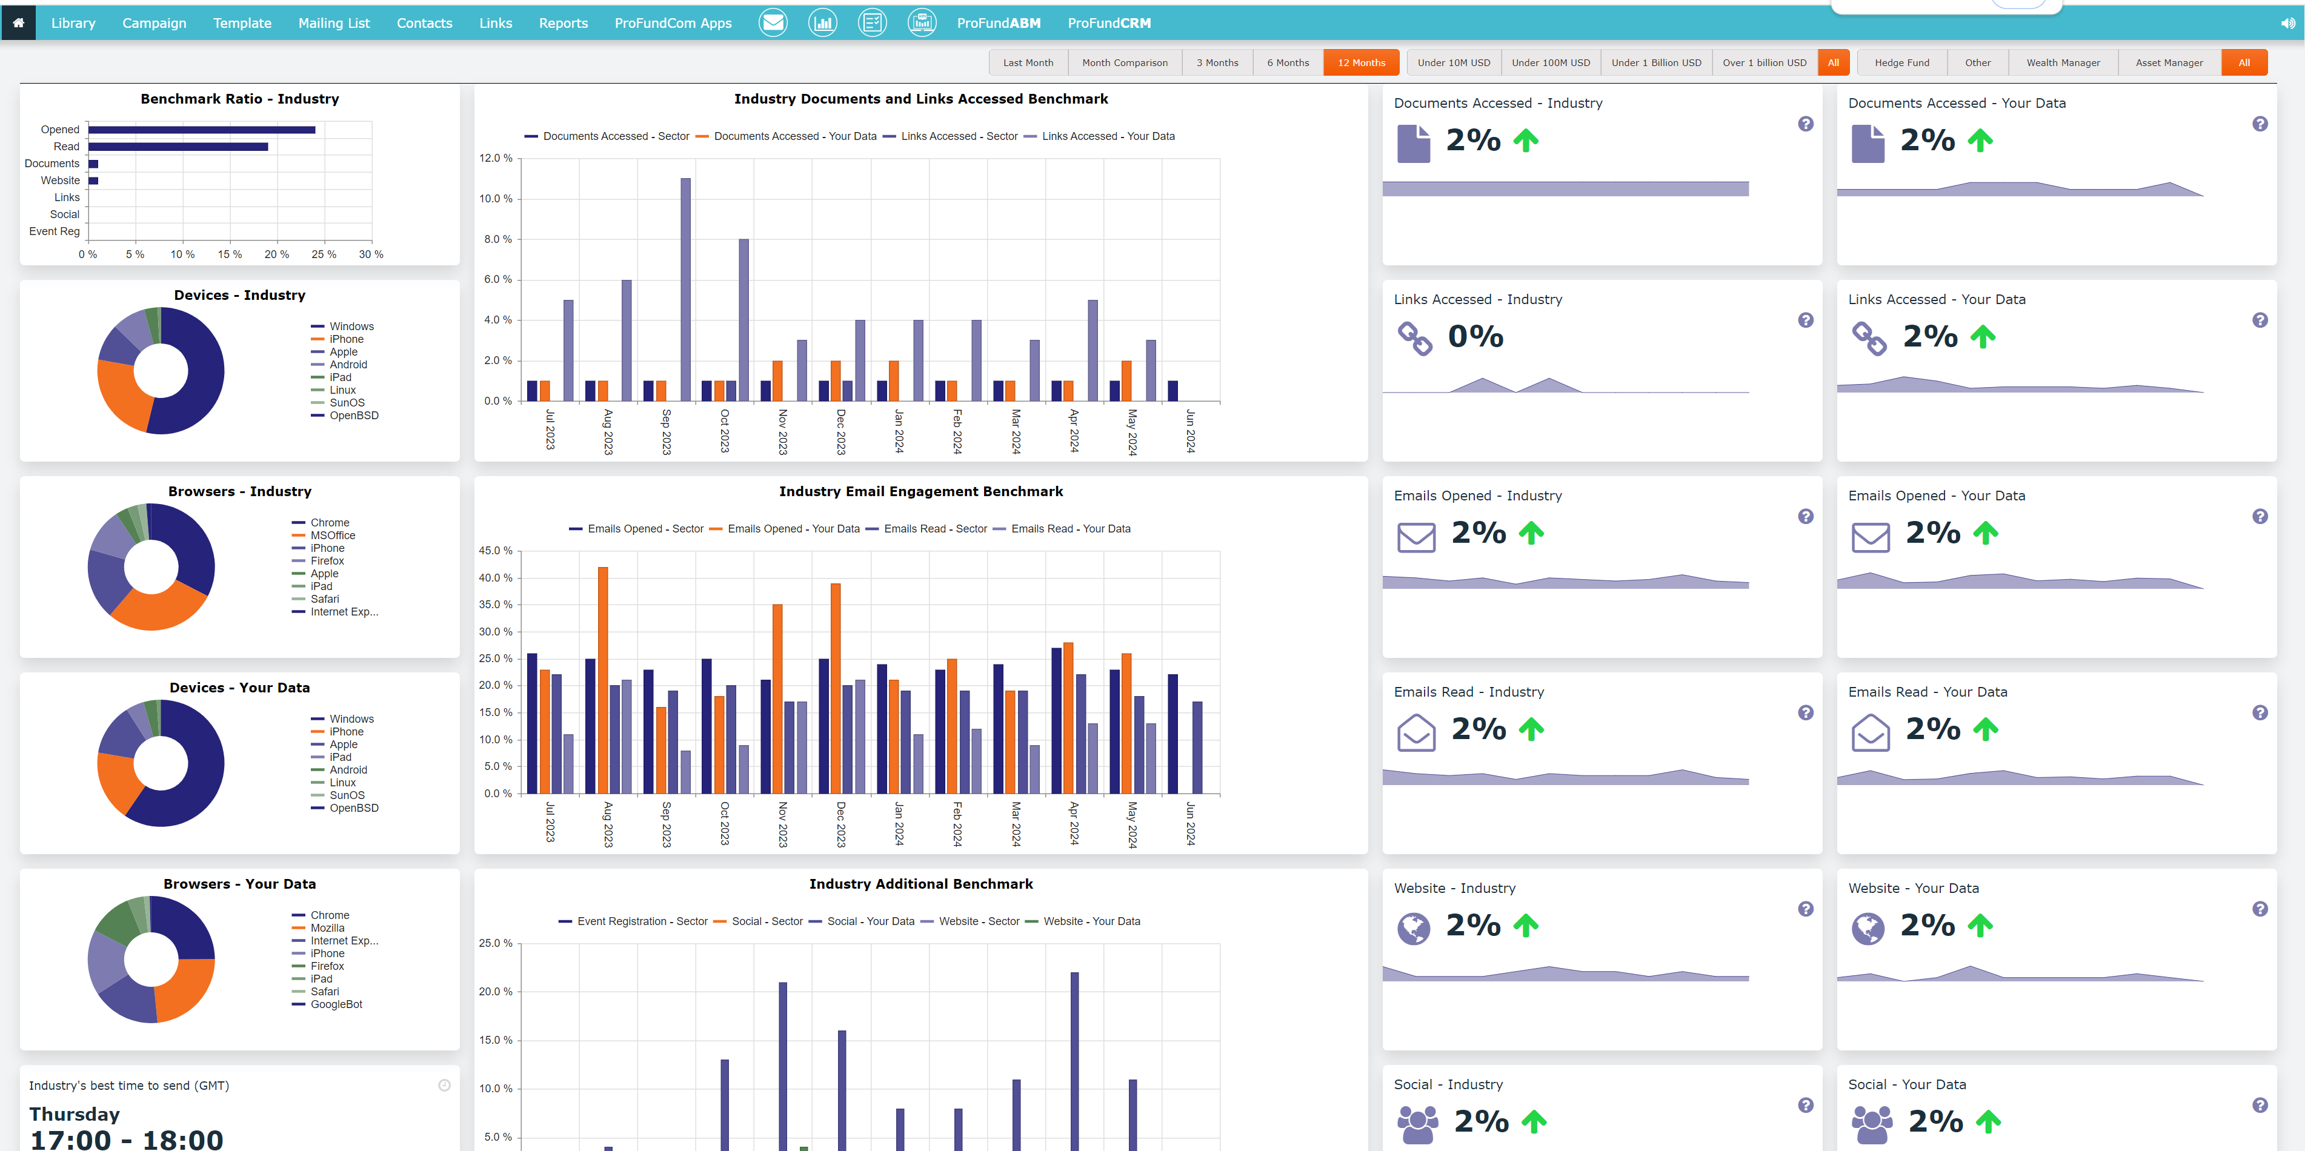
Demonstrating RoI
What demonstrates the value of marketing spend

Slide 27
9 Habits of Highly Successful Fund Marketers
Do or Don’t – There Is No Try
1
Brand Experience
4
Data Analysis
01
04
2
Content Generation
5
Demonstrating RoI
02
05
3
Planning
6
Sales Enablement
03
06
7
Internal Collaboration
07
8
Education
08
3
Deploying the right tools
09

Slide 28
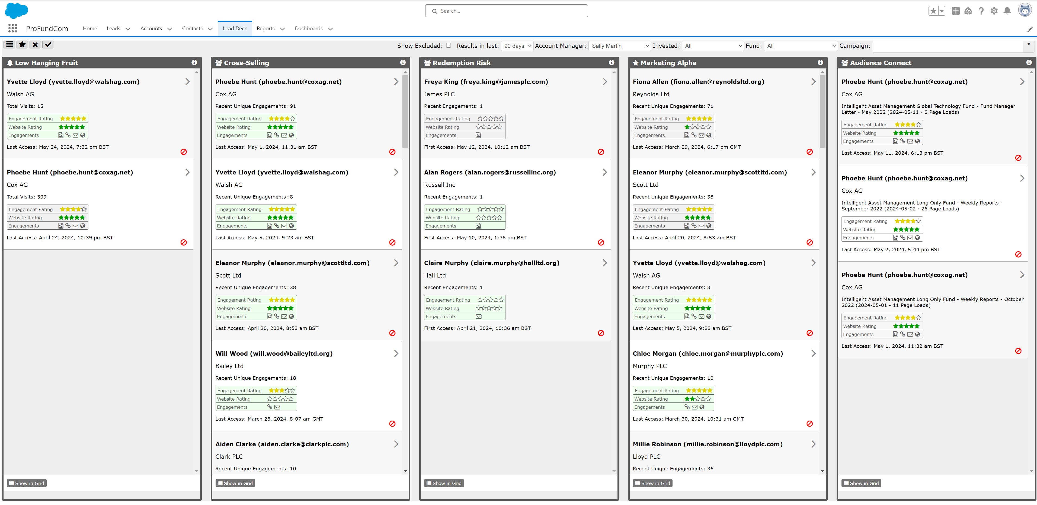
Sales Enablement
Deliver actionable insights to the sales team

Slide 29
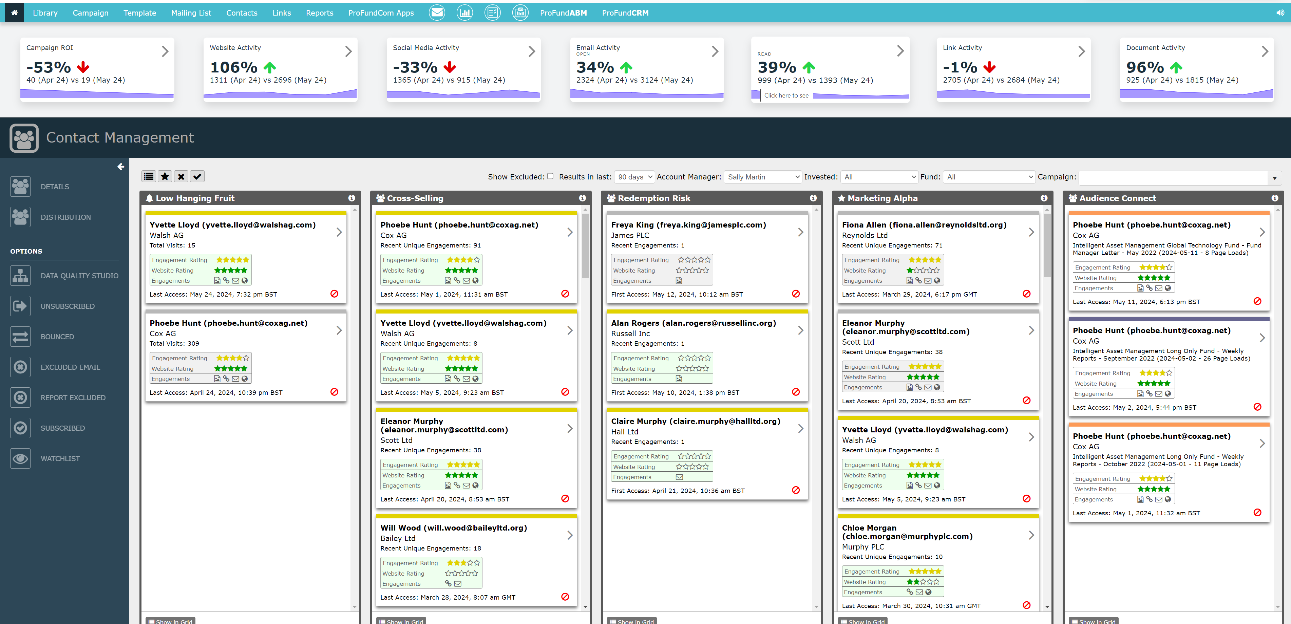
Sales Enablement
Deliver actionable insights to the sales team

Slide 30
9 Habits of Highly Successful Fund Marketers
Do or Don’t – There Is No Try
1
Brand Experience
4
Data Analysis
01
04
2
Content Generation
5
Demonstrating RoI
02
05
3
Planning
6
Sales Enablement
03
06
7
Internal Collaboration
07
8
Education
08
3
Deploying the right tools
09

Slide 31
Internal Collaboration
No person is an island
Technology Platforms: Utilize project management tools, communication platforms like Slack or Microsoft Teams, and collaborative document editing software to facilitate seamless information sharing and project coordination. Basecamp and Trello are the best options.
Standardized Processes: Establish clear and standardized processes for communication, decision-making, and project execution. This helps to streamline collaboration and avoid confusion.
Knowledge Sharing Initiatives: Encourage knowledge sharing through internal knowledge repositories, mentorship programs, or brown bag lunch sessions where employees can learn from each other's expertise.

Slide 32
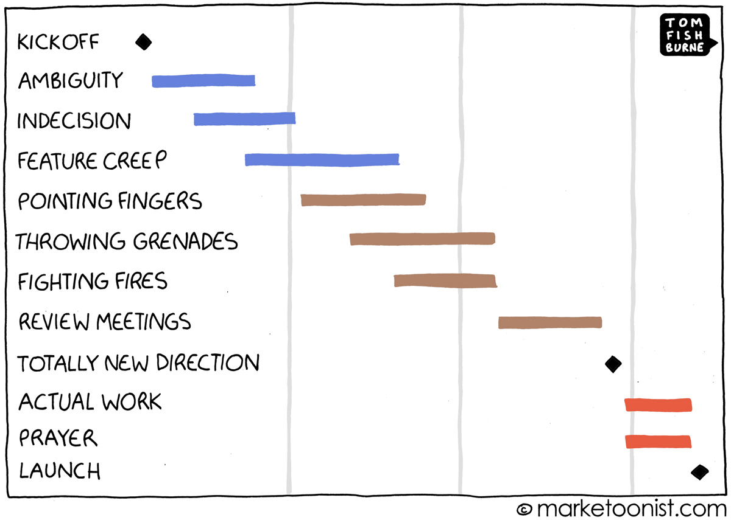
Internal Collaboration
No person is an island

Slide 33
9 Habits of Highly Successful Fund Marketers
Do or Don’t – There Is No Try
1
Brand Experience
4
Data Analysis
01
04
2
Content Generation
5
Demonstrating RoI
02
05
3
Planning
6
Sales Enablement
03
06
7
Internal Collaboration
07
8
Education
08
3
Deploying the right tools
09

Slide 34
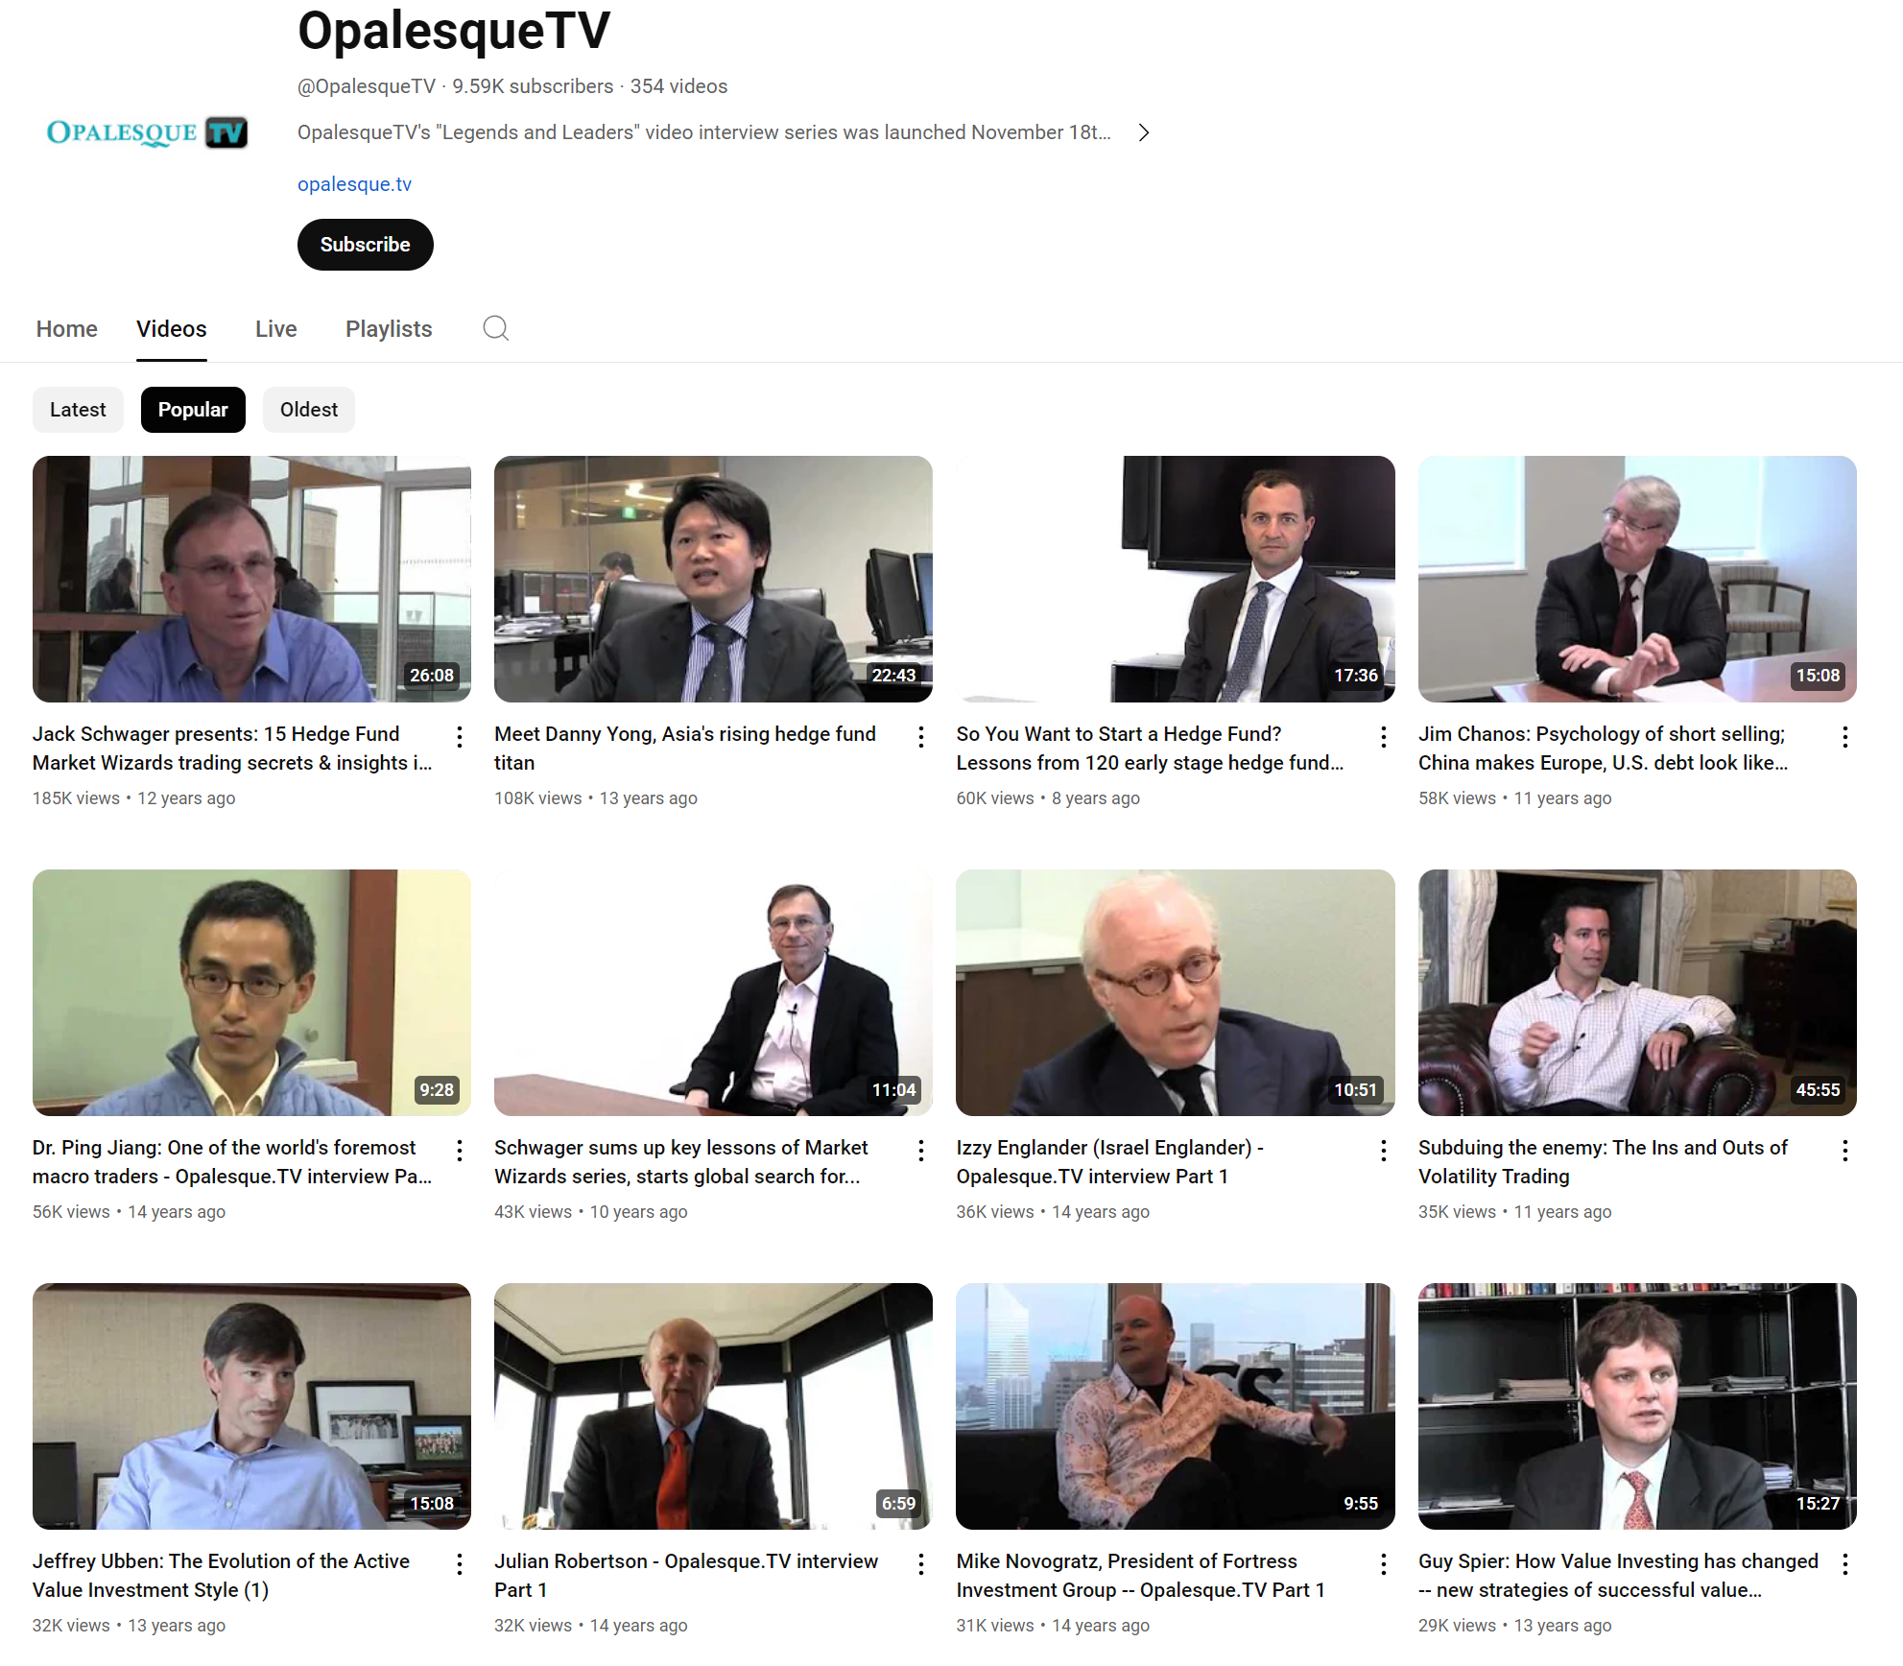
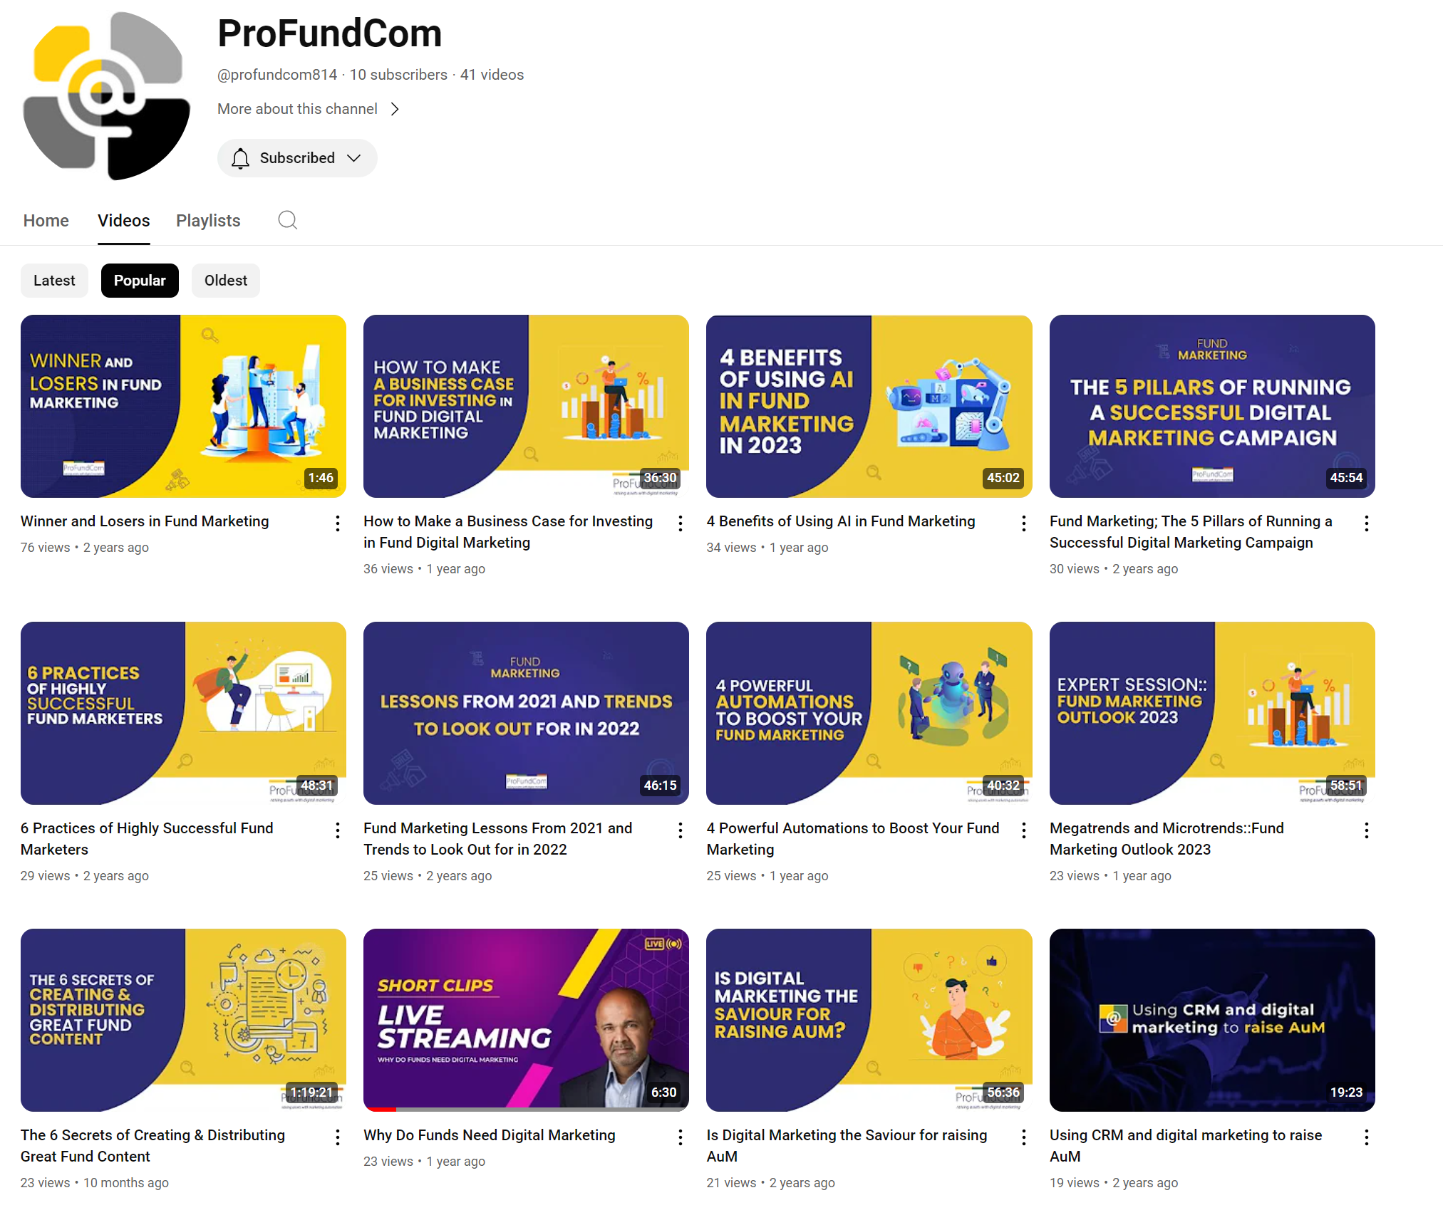
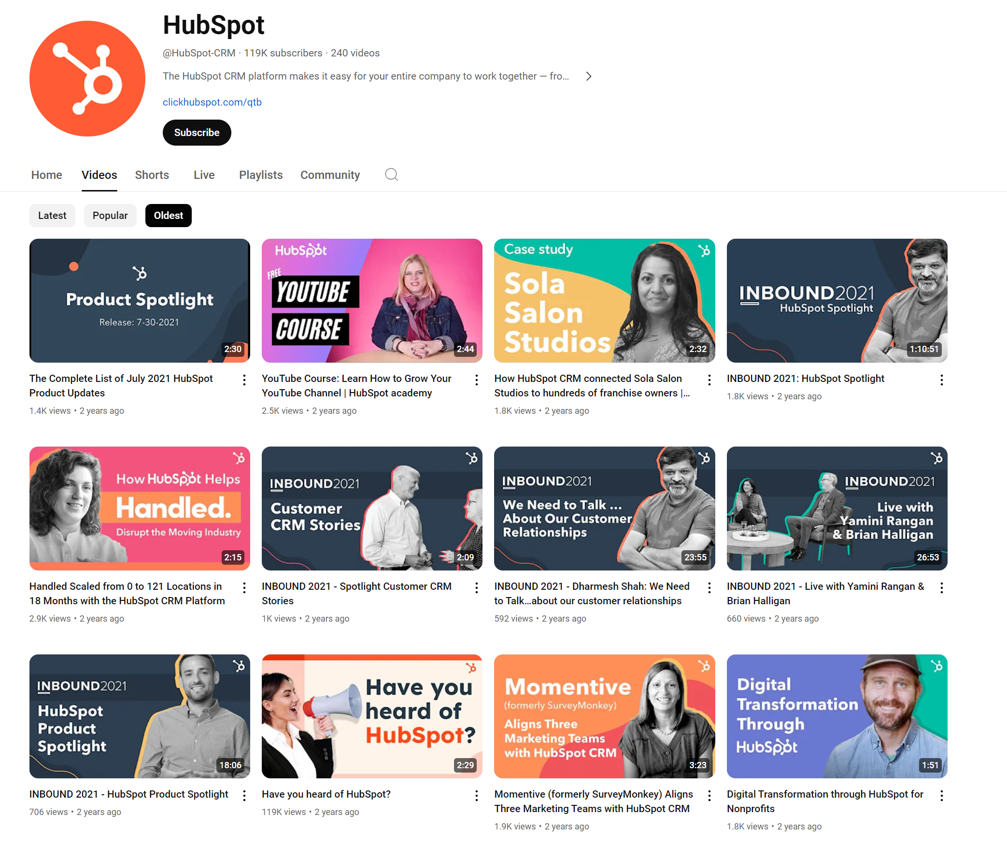
Education
Hey teacher leave those kids alone

Slide 35
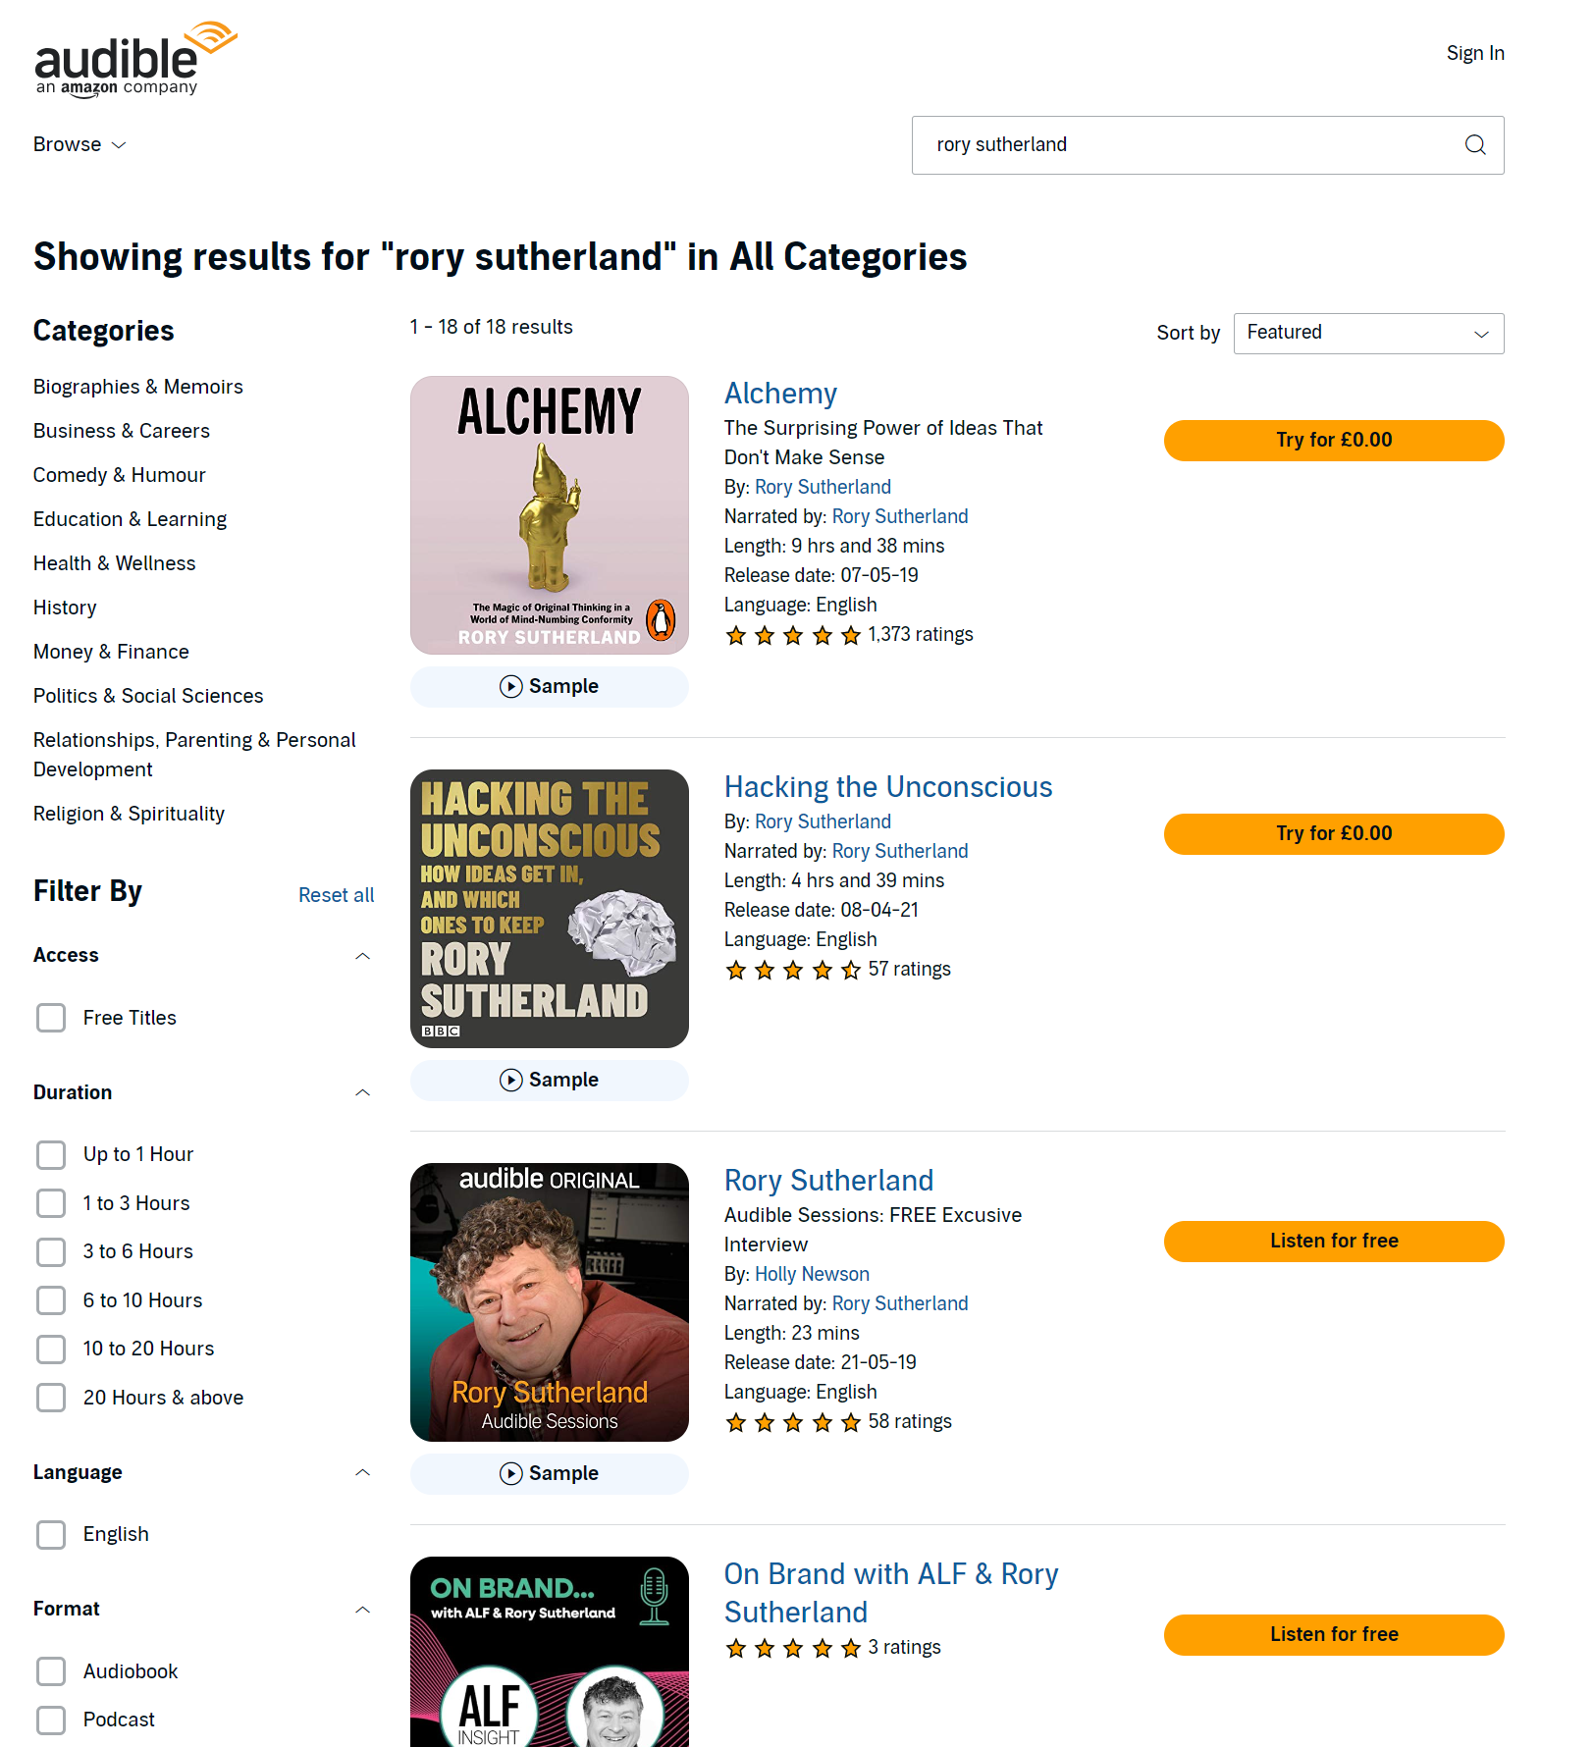
Education
Hey teacher leave those kids alone

Slide 36
9 Habits of Highly Successful Fund Marketers
Do or Don’t – There Is No Try
1
Brand Experience
4
Data Analysis
01
04
2
Content Generation
5
Demonstrating RoI
02
05
3
Planning
6
Sales Enablement
03
06
7
Internal Collaboration
07
8
Education
08
3
Deploying the right tools
09

Slide 37
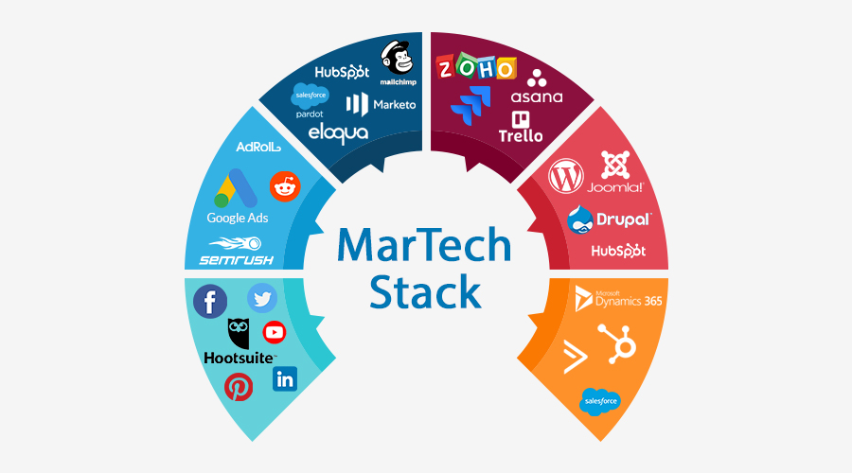
Lots Of Moving Parts – Marketing Is Hard
What Do We Need To Get Right?
CRM
DELIVERY
SEO
CONTENT
Social
ANALYTICS

Slide 38
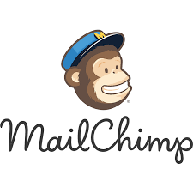













Lots Of Moving Parts
What Do We Need To Get Right?
DELIVERY
CHECKS
ANALYTICS
CONTENT

Slide 39
Lots Of Moving Parts
What Do We Need To Get Right?
DELIVERY
CHECKS
ANALYTICS
CONTENT

Slide 40
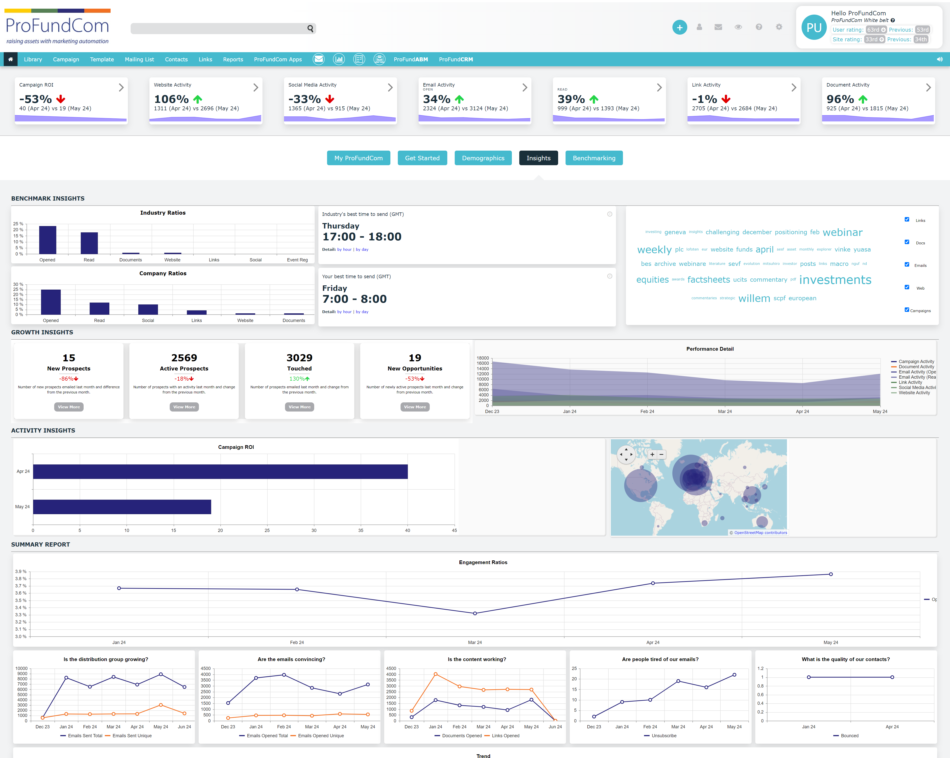
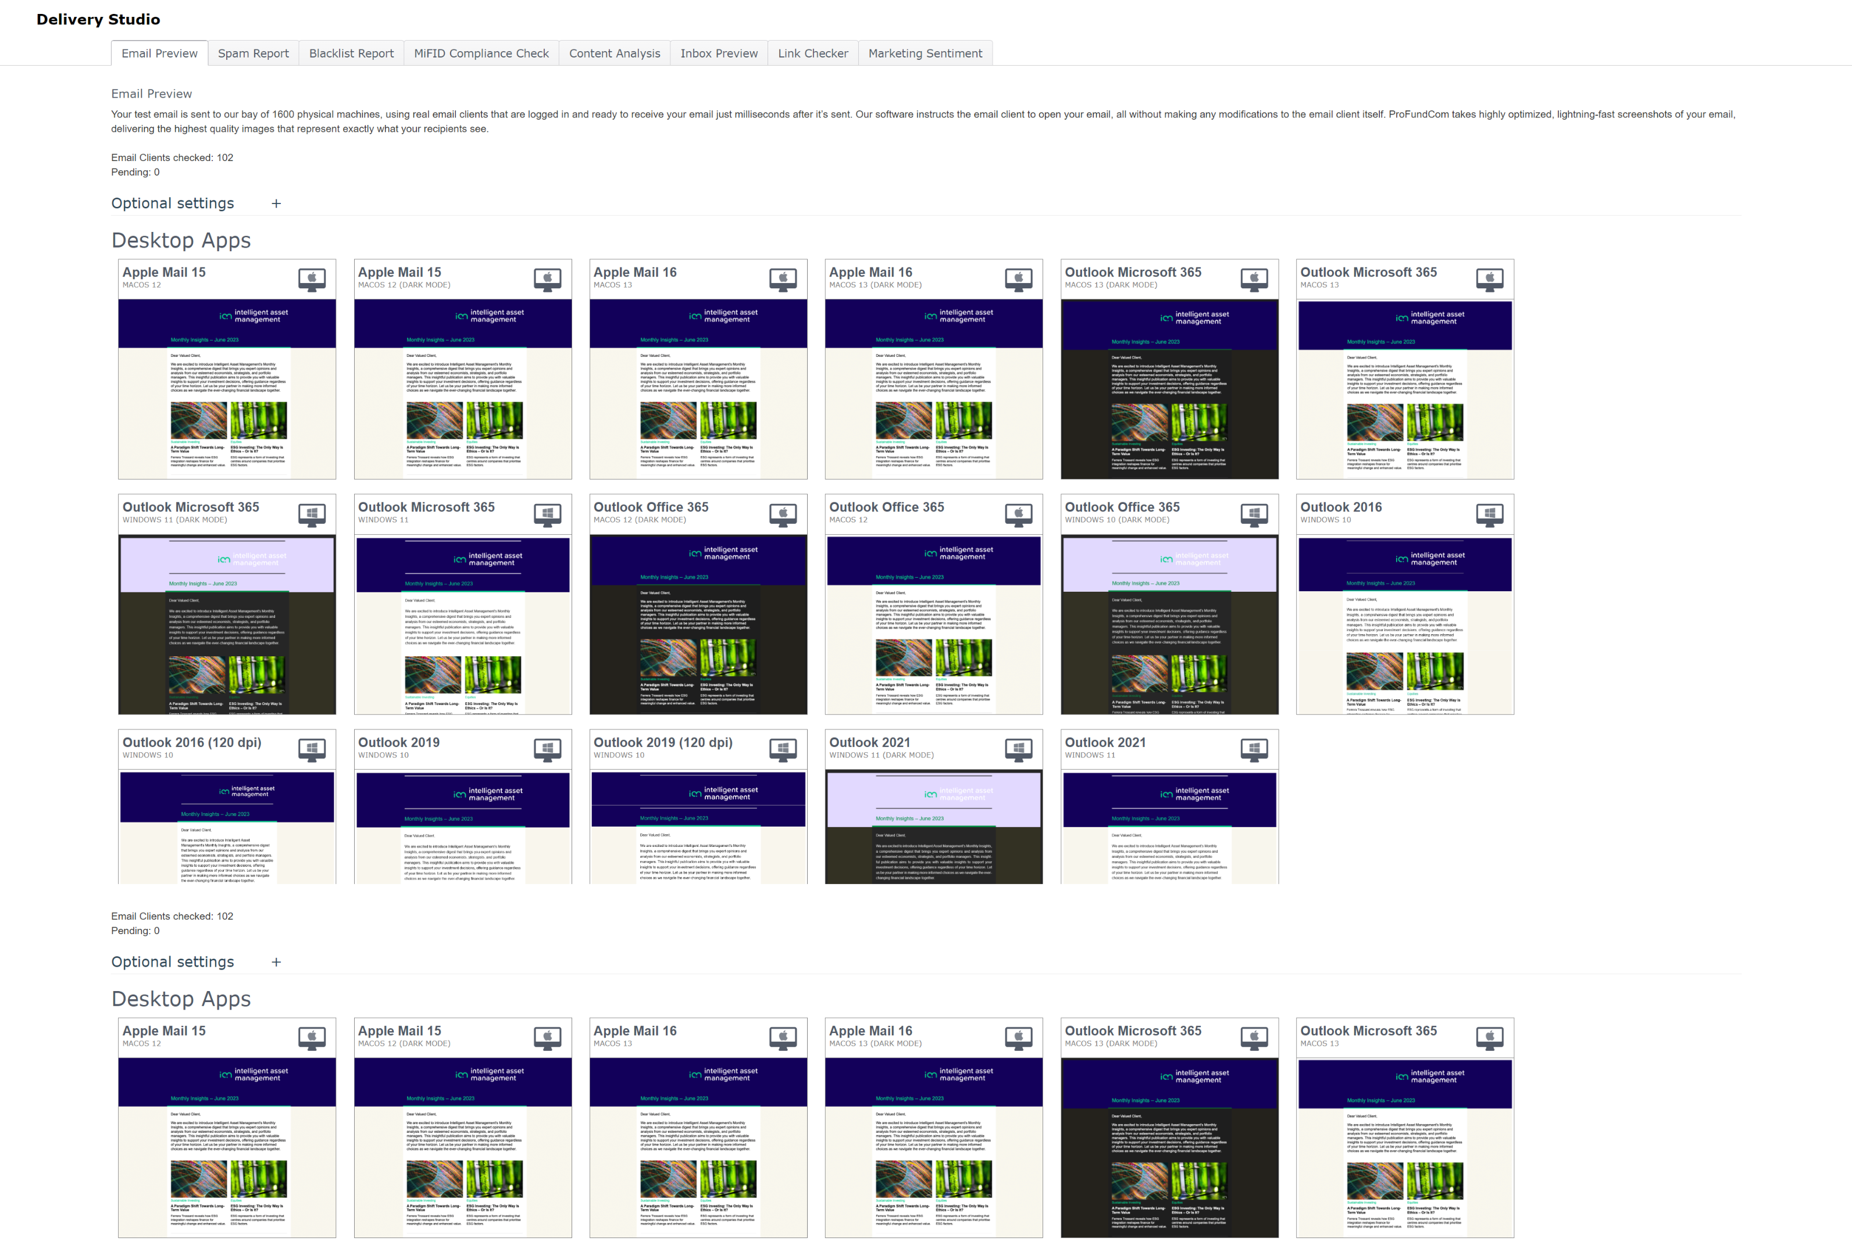
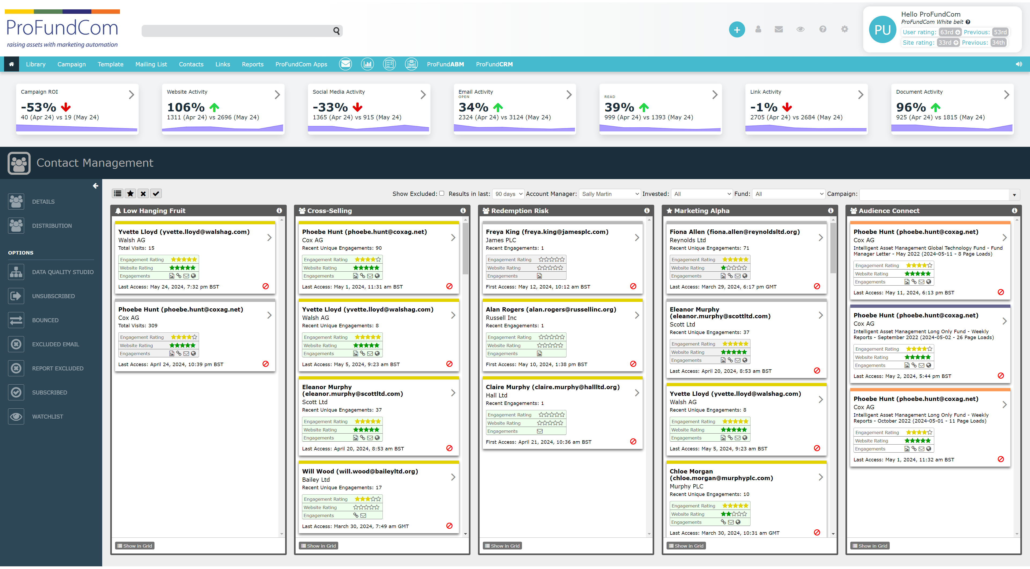
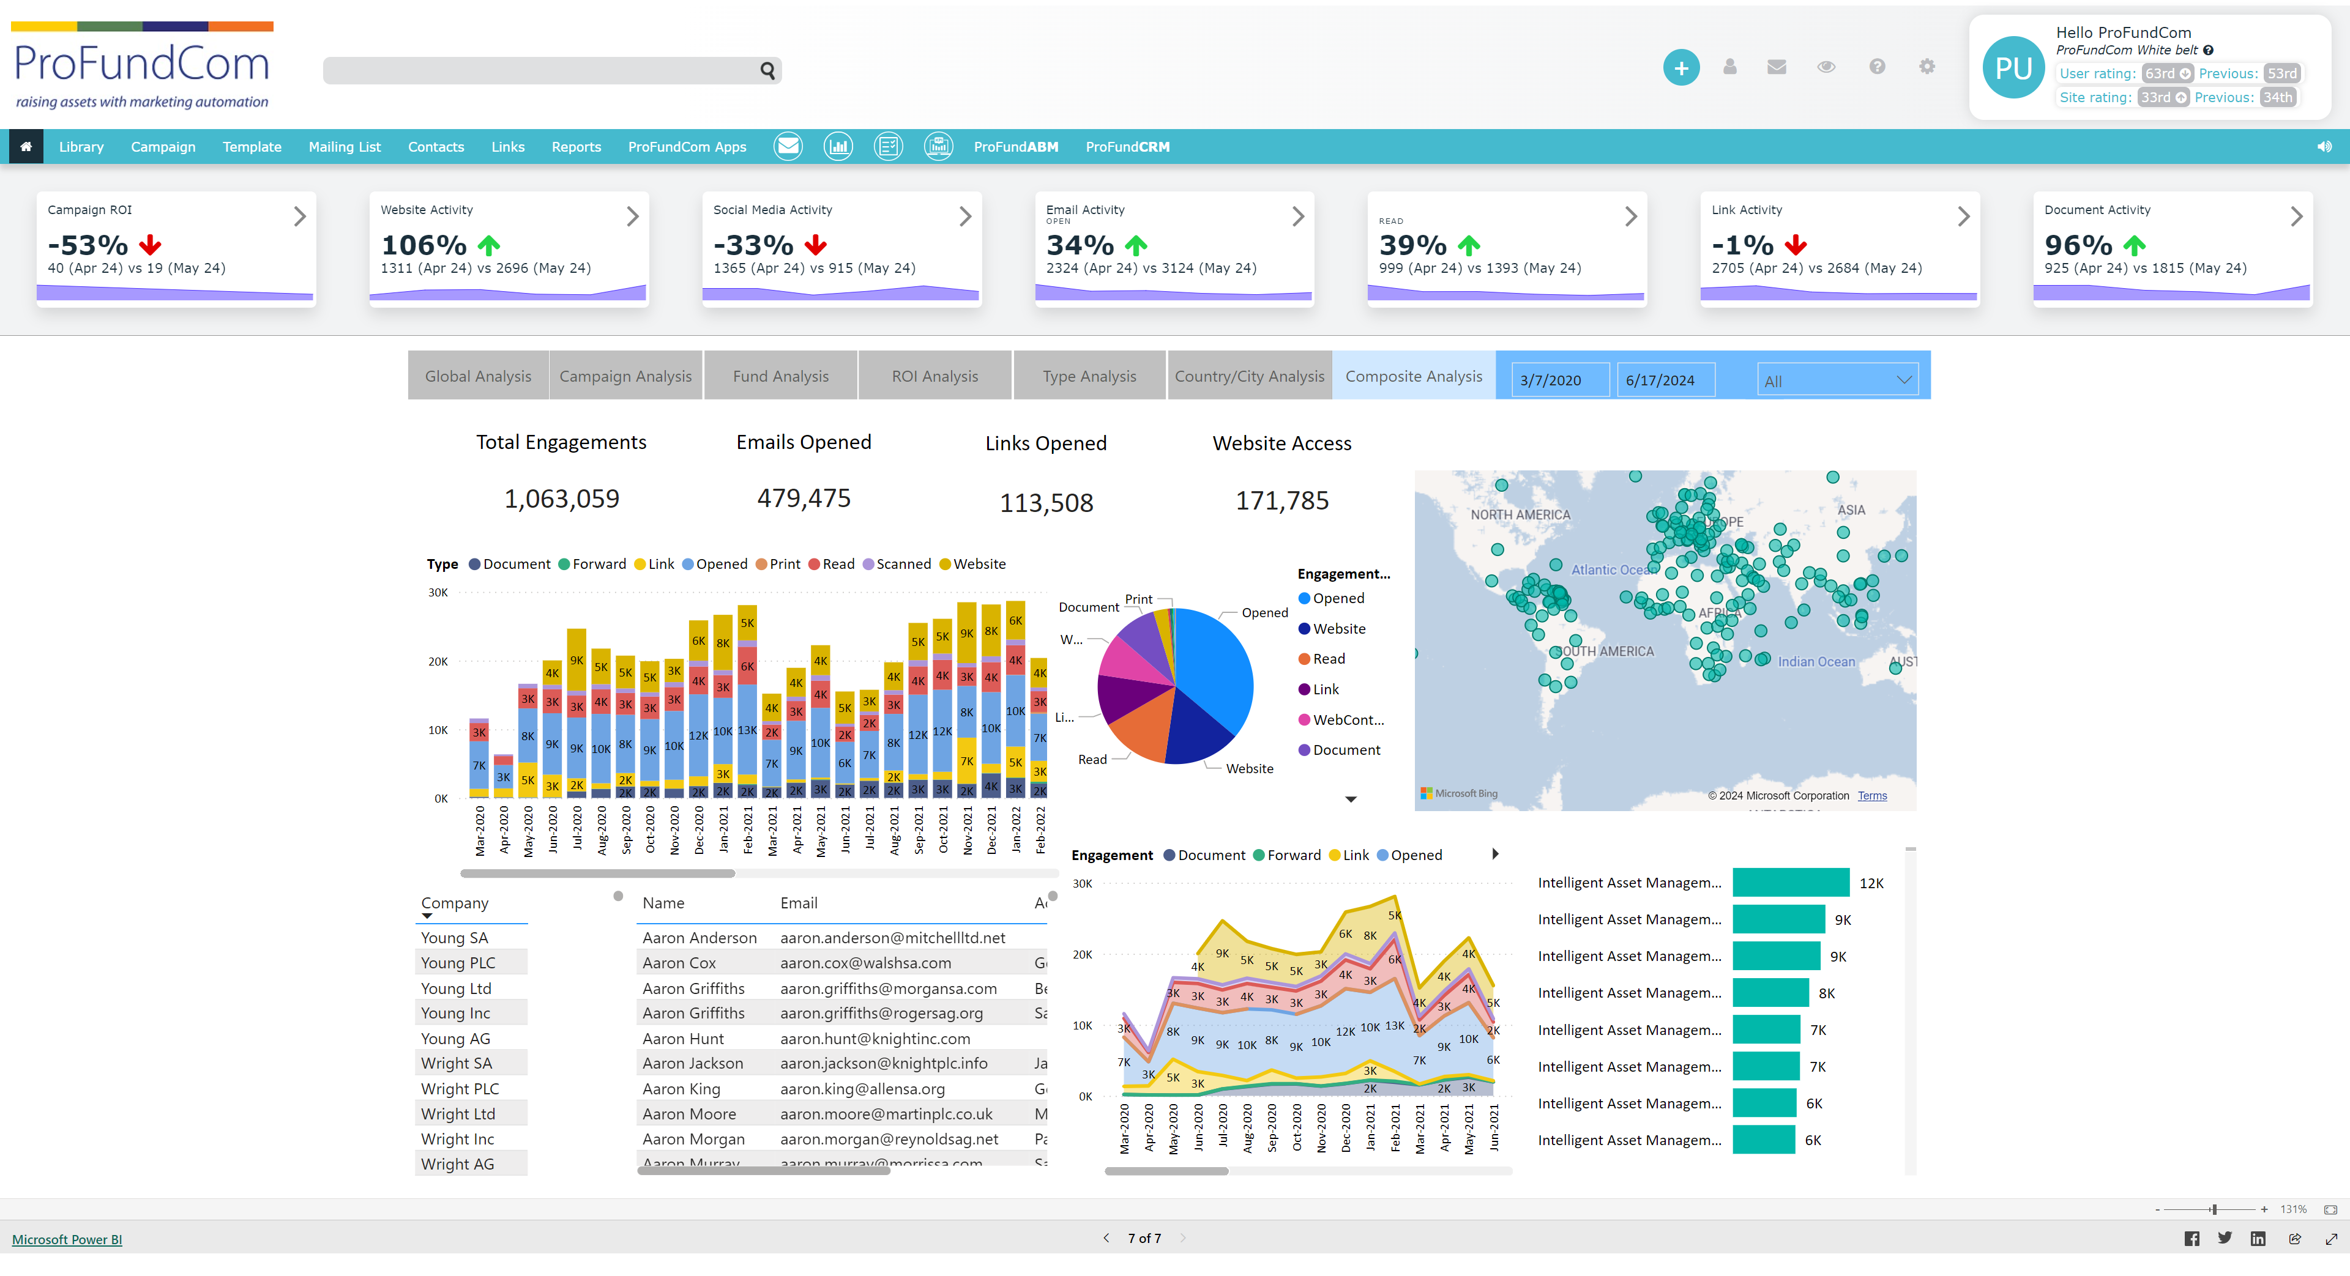
Lots Of Moving Parts
What Do We Need To Get Right?
DELIVERY
CHECKS
ANALYTICS
CONTENT

Slide 41
9 Habits of Highly Successful Fund Marketers
Do or Don’t – There Is No Try
1
Brand Experience
4
Data Analysis
01
04
2
Content Generation
5
Demonstrating RoI
02
05
3
Planning
6
Sales Enablement
03
06
7
Internal Collaboration
07
8
Education
08
3
Deploying the right tools
09

Slide 42
9 Habits of Highly Successful Fund Marketers
Do or Don’t – There Is No Try
Q& A

Slide 43
9 Habits of Highly Successful Fund Marketers

Paul Das
Founder + CEO - ProFundCom

